Slide 1
Self-supervised learning of inverse problem solvers in medical imaging
Tomer Weiss
MIL3ID workshop, MICCAI’19
October 2019

Slide 2
Motivation
Supervised learning for medical image reconstruction is inapplicable most of the time – lack of aligned datasets.
Recent progress in self-supervised learning for image processing
Notes:
As we all know the usage of supervised learning for medical imaging is most of the time impracticable due to difficulties in collecting the needed datasets.
On the other hand, we saw in the last few years significant progress in the area of SSL for natural images, such as the works of “zero-shot super resolution” and “deep image prior” which suggested the CNNs can use as strong prior.
Both reasons lead us to use self-supervised learning to solve inverse problems in medical imaging – solving inverse problem using neural networks without using any dataset.

Slide 3
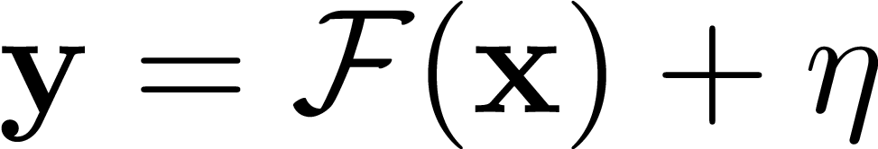
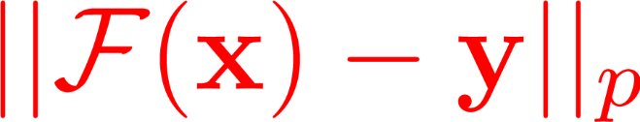
Inverse problems
Formulation:
Traditional prior-based solvers - MAP, maximum a posteriori formulation
Fidelity term
Prior term
Notes:
Short introduction on inverse problems:
Inverse problems trying to answer the following question: given the forward model (F) and the observed measurements (y) can we extract the latent signal (x)?
Traditional method to solve inverse problem usually uses MAP estimator which try to minimize the discrepancy in the measurements space together with prior term such as TV.

Slide 4
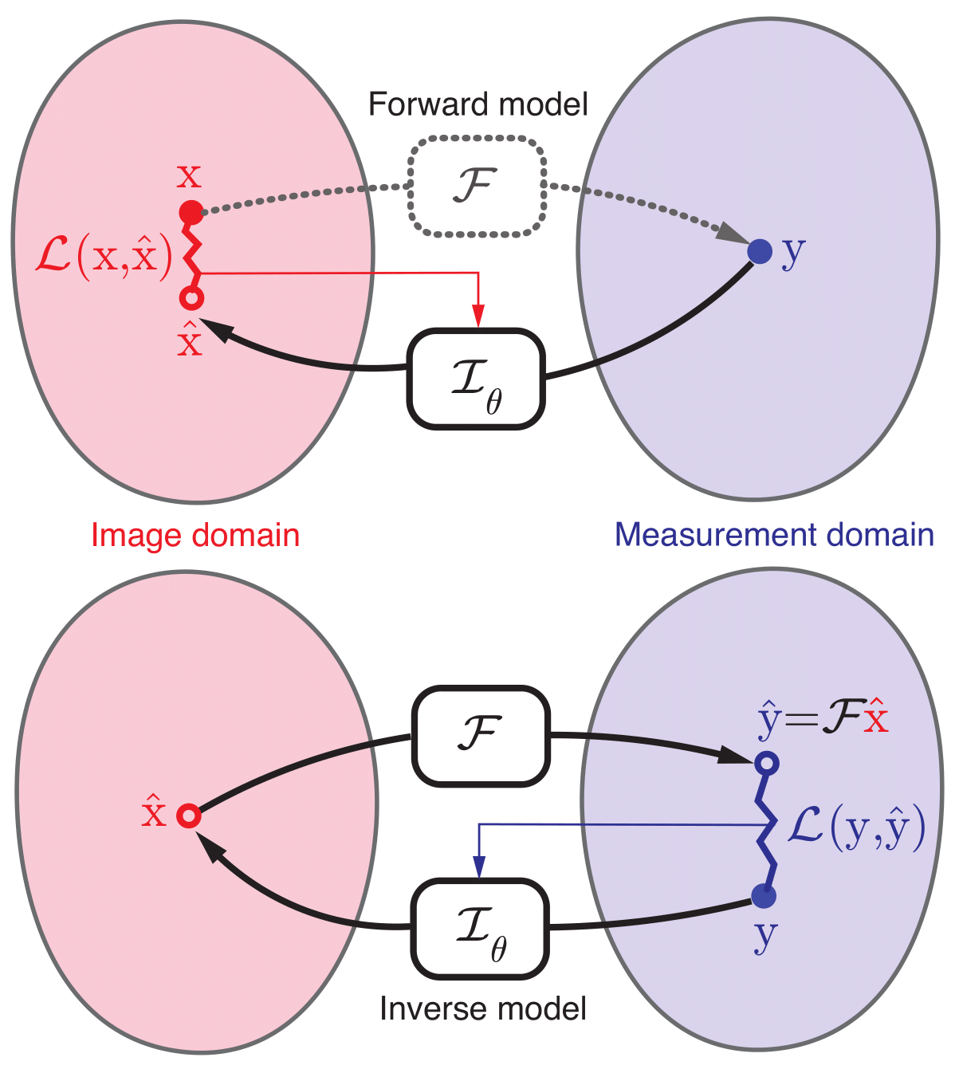
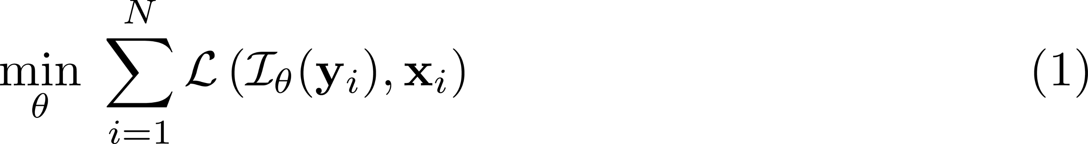
Supervised vs. Self-supervised
Supervised
Self-supervised
Inherent prior
Notes:
On the other hand, supervised learning using neural network to estimate the inverse operator and trying to minimize the discrepancy on the image domain on the training set. and as we know we need large dataset of measurements together with their annotated ground truths in order to succeed to generalized our model.
Self supervised suggest to combine the two approaches: again we use the NN to estimate the inverse operator, the difference is that now we used the forward model to come back to the measurements domain and minimize the discrepancy on it, same as used in traditional methods but this time the prior is the structure of the NN itself.

Slide 5
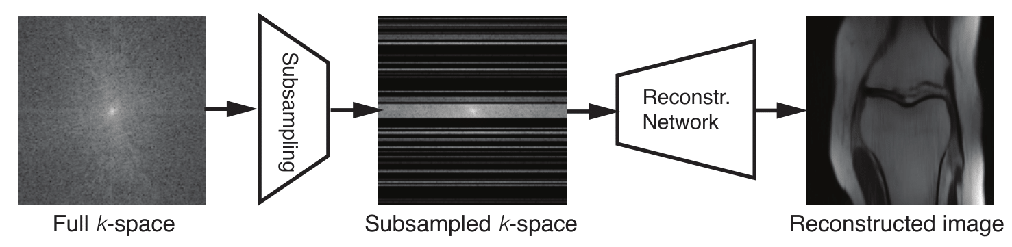
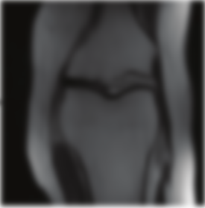

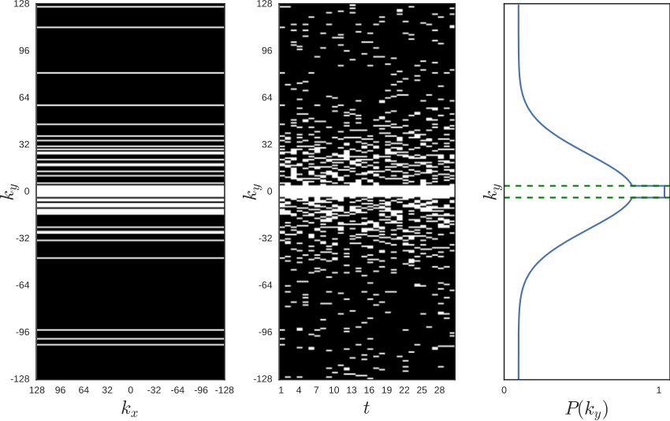


Use-case: accelerated MRI reconstruction
Supervised
$$ℒ(x,\hat{x})$$
Groundtruth
Self-supervised
$$ℒ(y,\hat{y})$$
Notes:
We example our method on the accelerated MRI reconstruction problem.
In supervised learning the measurements go throw reconstruction NN and the loss to optimize is the estimate the inverse opera between the reconstructed and the groundtruth images on the entire training set.
In self supervised the reconstructed image go throw the forward model, which in this-case is sub sampling in the furrier domain, to receive estimate of the measurements and then compared to the original measurements.
Where the loss to optimize in this case is the estimate the inverse opera in the measurements domain.

Slide 6
Results x4 acceleration
*Test set - 48 slices from 8 volumes (fastMRI dataset)
Notes:
Here we can see example of the result on two different forward models, SR and Dealiasing, with acceleration rate of 4.
We can see that SSL give us improvement of 2 to 3 dB over the traditional TV and get very close to the performance of supervised methods.

Slide 7
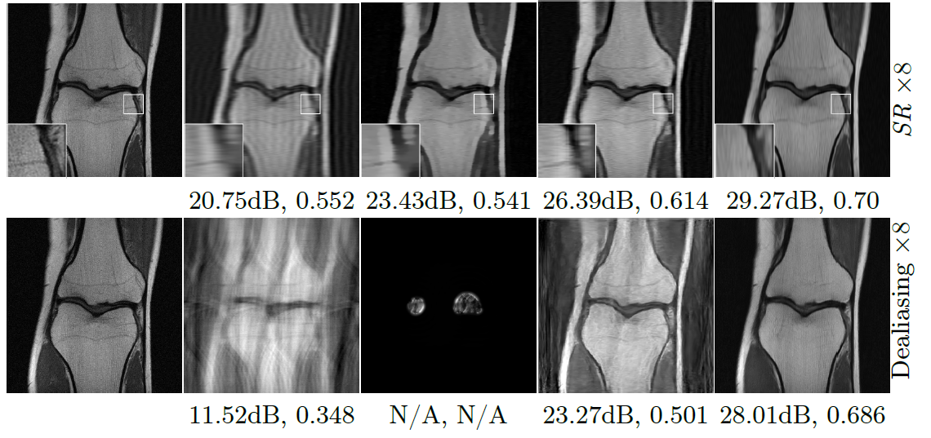
Results x8 acceleration
*Test set - 48 slices from 8 volumes (fastMRI dataset)
Notes:
On acceleration rate of 8 the margin compare to supervised learning is more significant but we can still see the 3dB margin over TV, we can also see that our method succeed to produce meaningful image even in the case of dealiasing for 8th time acceleration where TV totally failed.

Slide 8
Take-home message
Self-supervision/deep-image-priors in a general inverse problem setting works better then prior-based solvers (and get close to supervised learning).
Further research
  The sensitivity of the method to errors in the forward model.
  What happens in case the forward model is not available?
Notes:
To summarize: SSL works better then traditional inverse problem solvers using only the measurements and the forward model and even get close to the supervised scenario.
Two questions open for further research:
How much the model is sensitive to error in the forward model?
What can be done in the case the forward model is not available to us?

Slide 9

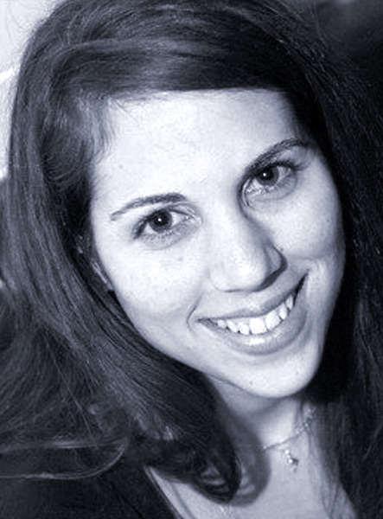
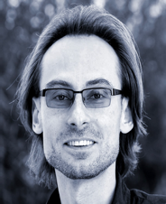
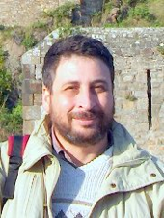
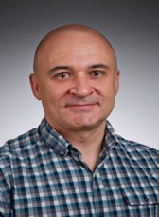
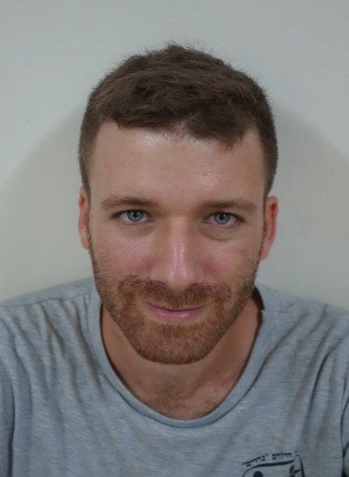
Joint work with:
Sanketh Vedula
CS, Technion
Ortal Senouf
CS, Technion
Alex Bronstein
CS, Technion
Michael Zibulevsky
CS, Technion
Oleg Michailovich
U of Waterloo
Thanks!

Slide 10
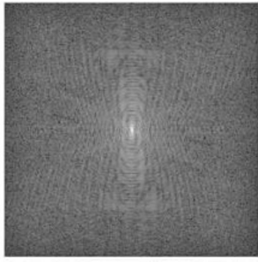
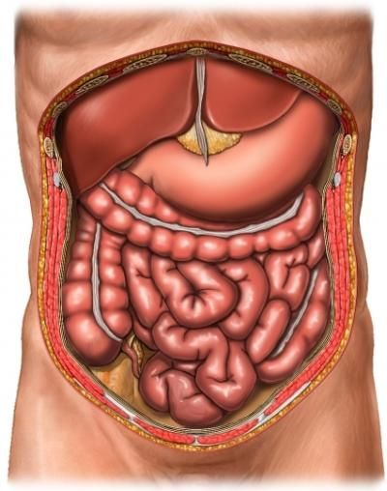
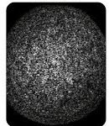
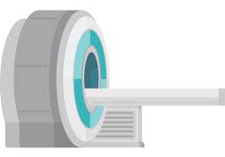
Inverse problems
Formulation:
Measurements
Forward model
Latent signal
Noise

Slide 11
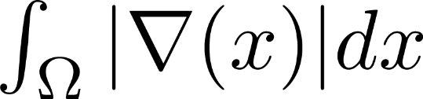
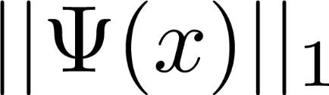
Traditional prior-based solvers
MAP, maximum a posteriori formulation
Common priors:
  Total Variation (TV)
  Sparsity w.r to a sparsifying transform
Fidelity term
Prior term
Notes:
Z- is sparse representation, x=Dz

Slide 12
Use-case: accelerated MRI reconstruction
Notes:
Phi is the fourier transform, and phi to the -1 is the inverse fourier transform

Slide 13

Experiment setting- inputs & loss functions
Loss:
Image domain fidelity term
K-space domain fidelity term
Cycle consistency
Notes:
Cycle- consistency is not discussed in the paper (~0.1db improvement in all experiments)
The weight of the k-space domain is set to be higher- is it because of the different orders of the losses?

Slide 14
Experiment setting- inputs & loss functions
Inputs:
  Measurements
  Coordinates grid
  Noise
Notes:
Cycle- consistency is not discussed in the paper (~0.1db improvement in all experiments)
The weight of the k-space domain is set to be higher- is it because of the different orders of the losses?

Slide 15
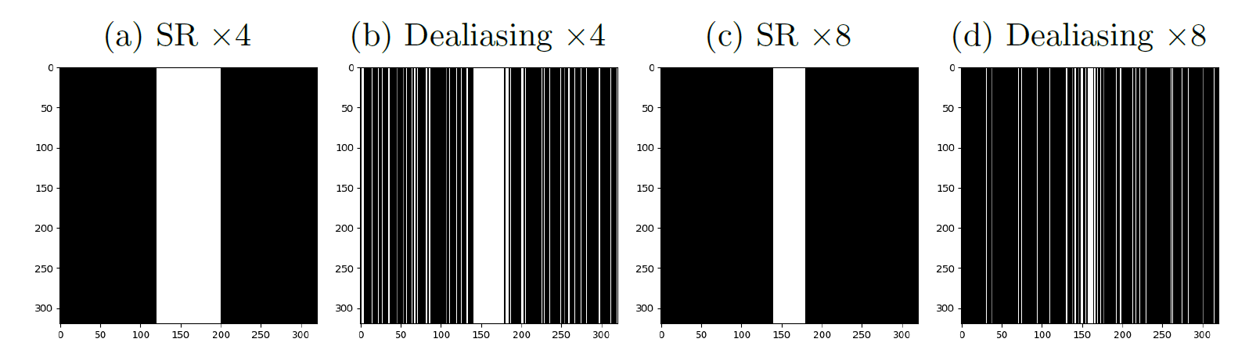
Experimental settings- different tasks
Data
NYU/Facebook fastMRI dataset
Training supervised framework - 34700 slices from 973 volumes
Testing and evaluating all methods - 48 slices from 8 volumes
Notes:
Aliasing- coarser sampling in the phase encoding domain.

Slide 16
Experimental settings- data
NYU/Facebook fastMRI dataset.
34700 slices from 973 volumes for training supervised framework
48 slices from 8 volumes for testing and evaluating all methods (supervised and prior-based)

Slide 17
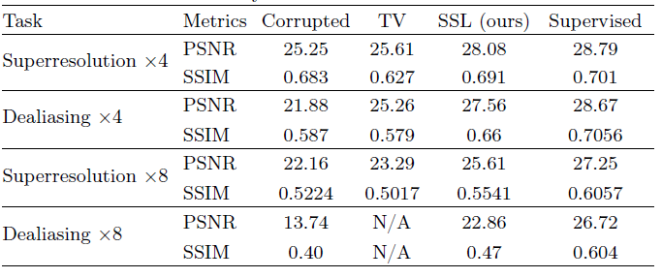
Results
Compared with TV-prior and supervised framework

Slide 18
Discussion
Improvement of ~2-3dB in PSNR, 0.05-0.08 in SSIM w.r to TV-prior.
A small gap in performance w.r to the supervised framework in the x4 acceleration scenario.
Loss design matters.
  Image domain vs. Fourier domain (k-space)
  Cycle consistency yields ~0.1dB improvement
Input matters.
Notes:
Ablation study

