Slide 1
Transfer Learning from Partial Annotations for
Brain Image Segmentation

Slide 2
Anatomical Prior in Partial Annotations
Fine segmentations for anatomical structures from the medical image can be difficult to acquire. There are not enough of them to train a robust machine-learning model.
Partial annotations are easier to generate (e.g. manual or semi-automatic) and the availability is much better.
The anatomical prior learnt from the partial annotation can be transferred for more detailed segmentation.

Slide 3
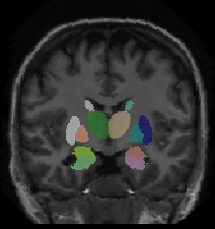
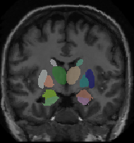
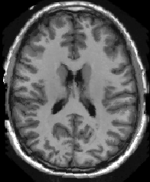
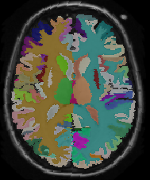
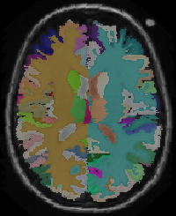
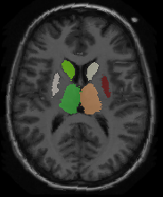
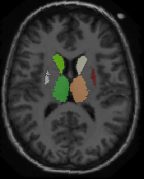
Framework
4000 subjects partial annotation
Prediction
3D UNET
Stage one: learning partial annotation with UNET.
Stage two: jointly learning whole and partial segmentation from features learnt in stage one.
Features
Partial and whole brain segmentation
Multi-output Network
Experts
Prediction

Slide 4
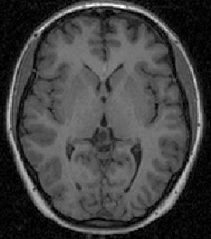
Implementation
Stage 2: Training jointly with partial and full annotations
Stage 1: Training with partial annotations
32
64
64+128
64
64
64
64
128
256+512
256
256
128+256
128
128
128
128
256
256
256
512
64+128
64
64
256+512
256
256
128+256
128
128
3X3 Conv+BN+LReLU
Maxpool
2X2 Up-conv
Concat
A vanilla UNET is adopted for training with partial annotation in stage one. An extra branch is added for whole brain segmentation in stage two.

Slide 5
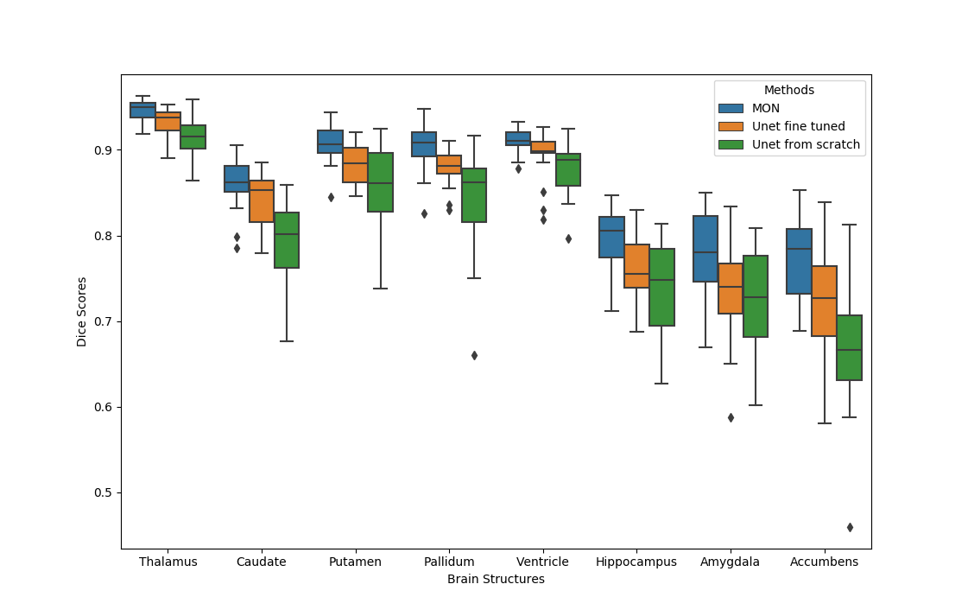
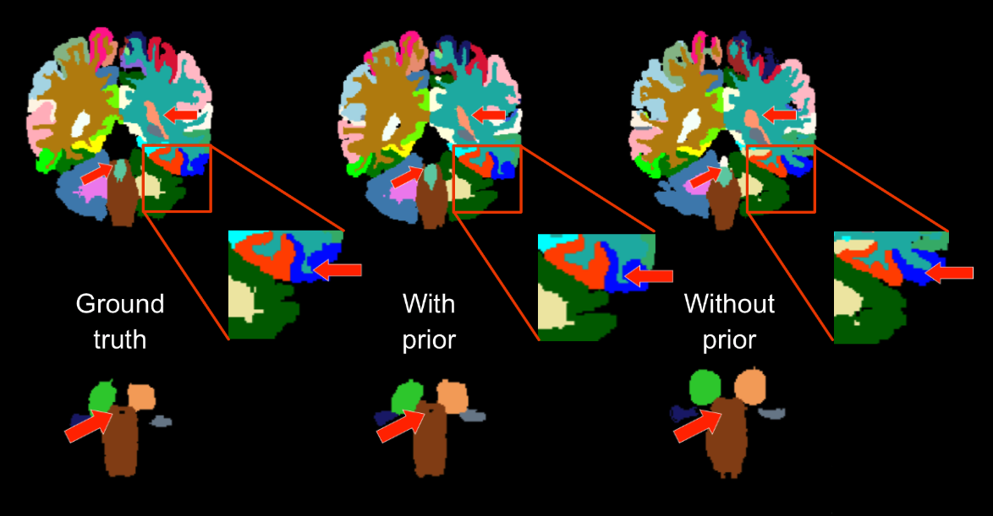
Results
Box-plot of Dice scores of models with and without incorporating transfer learning
Visual inspection of segmentation result

