Slide 1
Weakly Supervised Segmentation of Vertebral Bodies with Iterative Slice-Propagation
Shiqi Peng¹, Bolin Lai¹, Guangyu Yao², Xiaoyun Zhang¹, Ya Zhang¹,
Yan-Feng Wang¹, Hui Zhao²
¹ Shanghai Jiao Tong University, Cooperative Medianet Innovation Center
² Shanghai Jiao Tong University Affiliated Sixth People’s Hospital
MIL3ID workshop
2019.10.17

Slide 2
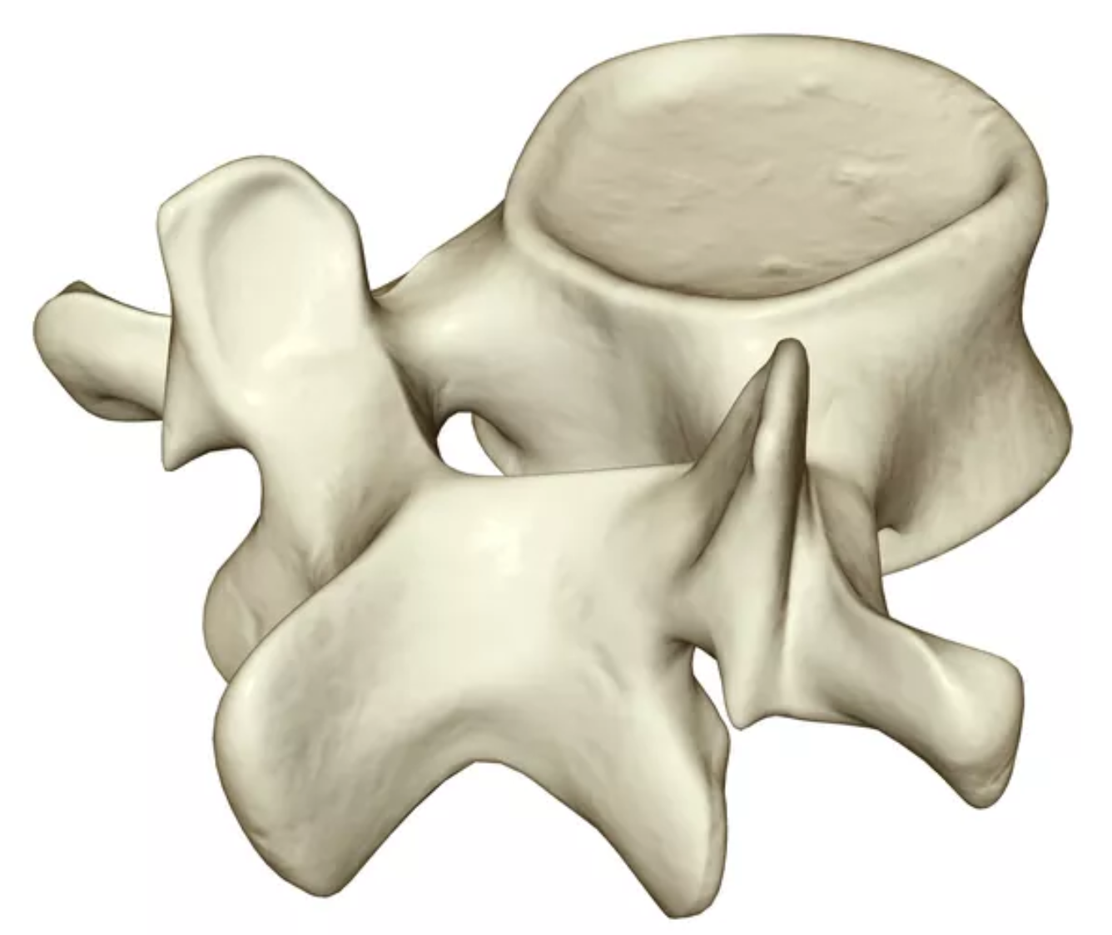
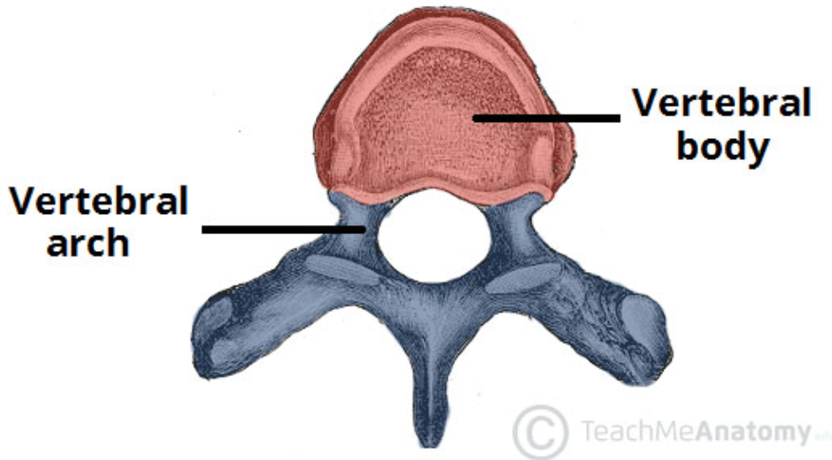
Background
Segmentation of VBs:
  Assessment of spinal deformities
  Detection of vertebral fractures
  Computer-assisted surgical interventions
Previous work:
  Model-based methods
  Graph-based methods
  Machine learning based methods
  Convolutional neural networks
Same drawback: pixel/voxel-wise annotations!
Notes:
Segmentation of the VBs from CT images is often a pre-requisite for many computational spine imaging tasks, such as assessment of spinal deformities, detection of vertebral fractures, and computer-assisted surgical interventions.
In the past few years, there exists many work on VB segmentation.
However, all these methods have a same drawback that they require pixel or voxel-wise labeled CT or MR scans to train models.
It is desired to leverage less fine-grained labels for segmentation so as to save the labeling cost.

Slide 3
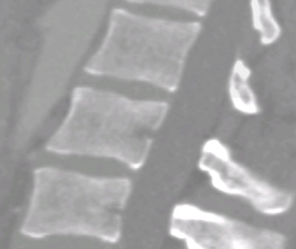
Motivation
The normal VBs are roughly quadrilateral from the sagittal view.
Annotate the position of a VB with four corner landmarks in the mid-sagittal slice.
Adopt the self-training strategy to fine-tune the segmentation model.
Adopt the slice-propagated method to expand to all sagittal slices.
Corner landmarks annotation
[1] Cai, Jinzheng, et al. "Accurate weakly-supervised deep lesion segmentation using large-scale clinical annotations: Slice-propagated 3d mask generation from 2d recist." MICCAI, 2018.
Notes:
Considering that the normal VBs without fractures are roughly quadrilateral from the sagittal view,
we thus propose to annotate the position of a VB with four corner landmarks in the mid-sagittal slice and utilize them as weak labels for segmentation.
Then we adopt the self-training strategy and the slice-propagated method, to obtain the more accurate volumetric result.

Slide 4
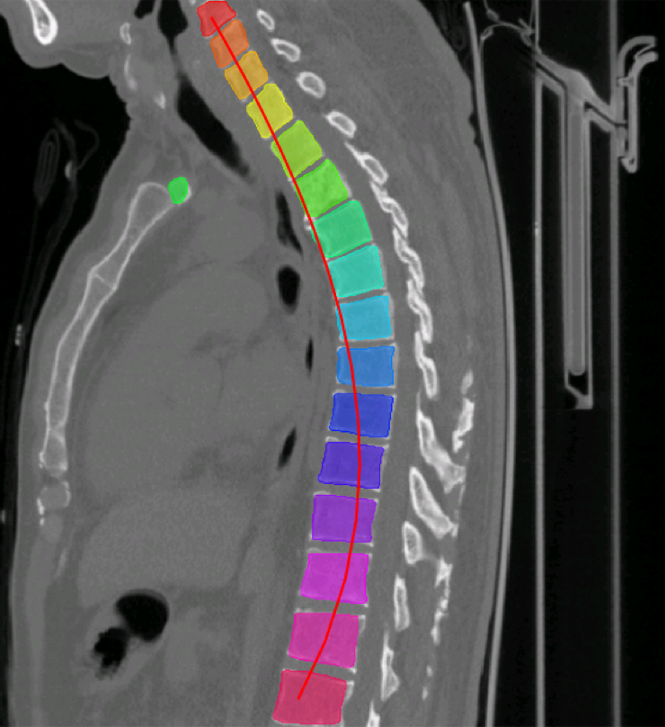
Sagittal slice segmentation
Segmentation Model
Mid-Sagittal
Label Refinement
Output mask
Confident Prediction Selection
CRF
Notes:
First, we concentrate on the segmentation of the mid-sagittal slice.
We first connect four corner landmarks to construct the coarse quadrilateral training labels for the mid-sagittal slices.
Then a base segmentation model is trained using these coarse labels.
Such labels are refined by selecting the most confident predictions and recovering the boundaries by fully connected CRF, thus additional supervisions are obtained.
By repeating training and refining procedures, we can achieve better segmentation results and get a better segmentation model.

Slide 5
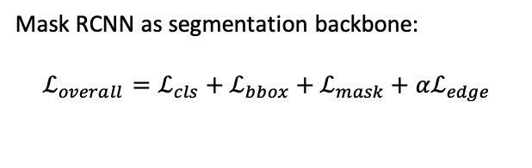
Sagittal slice segmentation
Segmentation Model
Mid-Sagittal
Label Refinement
Output mask
Confident Prediction Selection
Mask RCNN as segmentation backbone:
$$ℒ_{overall}=ℒ_{cls}+ℒ_{bbox}+ℒ_{mask}+αℒ_{edge}$$
CRF
[1] He, Kaiming, et al. “Mask r-cnn.” ICCV 2017.
[2] Sarker, Md Mostafa Kamal, et al. "SLSDeep: Skin lesion segmentation based on dilated residual and pyramid pooling networks." MICCAI 2018.
Notes:
In our method, Mask R-CNN is selected as the segmentation backbone for its quite good performance on instance segmentation task.
We adopt an edge loss to encourage the model pay more attention on the possible edge areas.

Slide 6
Sagittal slice segmentation
Segmentation Model
Mid-Sagittal
Label Refinement
Output mask
Confident Prediction Selection
2. Selection and rejection
CRF
1. Curve fitting
Notes:
Then, we propose a confident prediction selection method as a post-processing to avoid passing errors to the next iteration.
Considering the prior knowledge that VBs are generally arranged in a column, we then fit a curve based on the center points of the confident ROIs.
ROIs close to this curve are selected, and otherwise rejected.

Slide 7

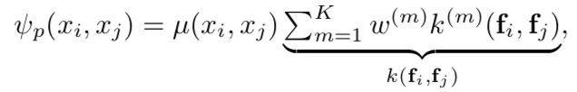
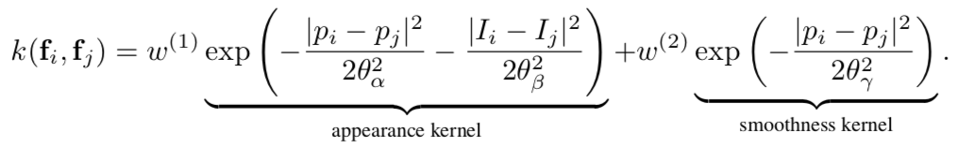
Sagittal slice segmentation
Segmentation Model
Mid-Sagittal
Label Refinement
Output mask
Confident Prediction Selection
CRF
[1] Krähenbühl, Philipp, and Vladlen Koltun. "Efficient inference in fully connected crfs with gaussian edge potentials." NeurIPS 2011.
Notes:
Finally, inspired by deeplab, we adopt denseCRF to establish pairwise potentials on all pairs of pixels in the image, thus refine the labels.

Slide 8
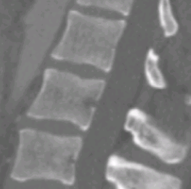
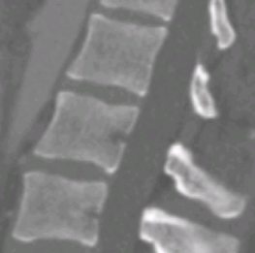
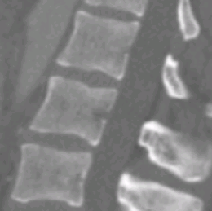
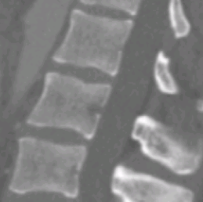
Slice-propagated segmentation
Segmentation Model
Mid-Sagittal
Label Refinement
Output mask
Expand training data
3-Slice Propagated
Confident Prediction Selection
Label Refinement
Expand training data
5-Slice Propagated
CRF
Label Refinement
Expand training data
……
Notes:
In order to generate VB segmentations for all sagittal CT slices, we train the segmentation model in a slice-propagated manner.
At the beginning, we only have the mid-sagittal slices with annotations as training data.
After we train a segmentation model via the self-training method introduced above, we then apply this model to the adjacent slices from the entire training set to obtain their initial annotations, and append these slices to training data.
Then we fine-tune the previous segmentation model with the extended training data until the model converges.
As this procedure proceeds iteratively, we can gradually obtain the converged VB segmentation results across all CT slices, and then a volumetric segmentation can be produced by stacking the slice-wise segmentations.

Slide 9
Experiments
Dataset
The spinal metastasis dataset (private):
  Training: 284 CT scans with 3400 VBs
  Testing: 95 CT scans with 1109 VBs
The lumbar spine dataset (public):
  10 scans (all for test)
Notes:
This is the description of our datasets.
We train and evaluate the model on our private spinal metastasis dataset.
And then directly evaluate on the public lumbar spine dataset, using all 10 CT scans.

Slide 10
Experiments
Mid-sagittal slices segmentation via self-training
 | DSC | ACC | SEN | SPE
UNet | 86.5 | 95.1 | 79.3 | 98.8
Unet-ST | 88.6 | 95.5 | 86.8 | 97.5
M | 87.6 | 97.8 | 81.2 | 99.6
M-E | 87.8 | 97.8 | 82.3 | 99.4
M-E-R | 89.6 | 98.0 | 89.8 | 98.8
M-E-R-ST | 90.1 | 98.1 | 88.8 | 99.1
n-M | 85.6 | 97.4 | 79.6 | 99.3
n-M-E | 86.2 | 97.6 | 79.4 | 99.5
n-M-E-R | 86.2 | 97.6 | 79.5 | 99.5
n-M-E-R-ST | 89.3 | 97.9 | 90.6 | 98.6
DSC: Dice similarity coefficient
ACC: Accuracy
SEN: Sensitivity
SPE: Specificity
M: Mask-RCNN
E: Edge loss
R: Refinements
ST: Self-training
n-: Noisy dataset
Notes:
These are the performances evaluated on our spinal metastasis dataset.
In practice, errors are inevitable in the manual annotations. A generic segmentation method should be robust enough against these labeling noises.
Thus we build a noisy dataset by randomly shifting the four corner landmarks by 0 to 1 mm and conduct experiments again on this noisy dataset.
The experimental results show that though the overall performance is decreased, self-training is still effective.

Slide 11
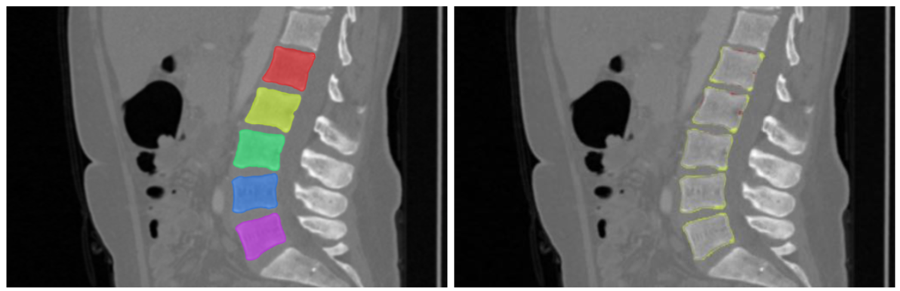
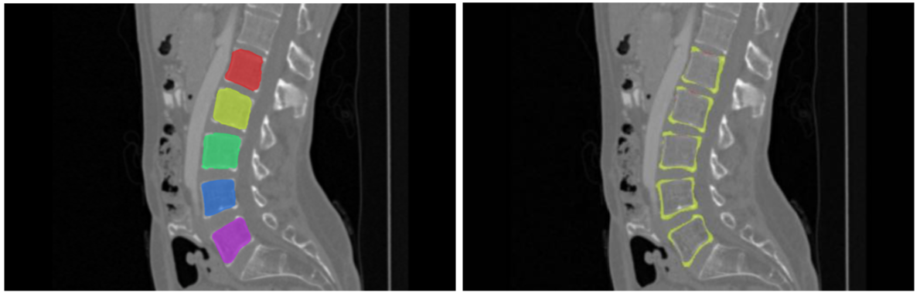
Qualitative Results
Notes:
These are the qualitative results for mid-sagittal slices.
Actually, they can be well-segmented.

Slide 12
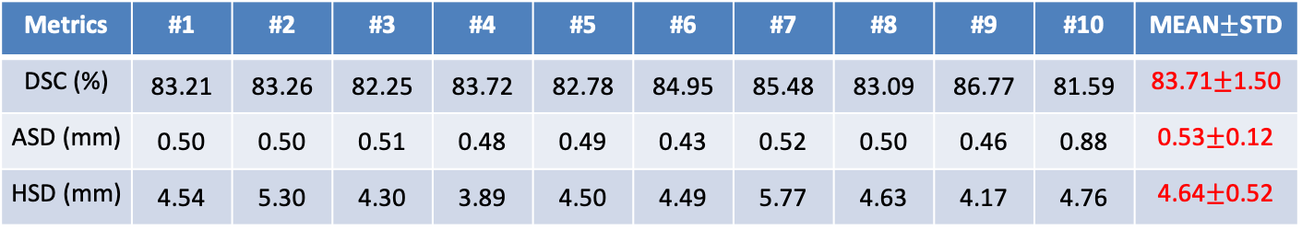
Experiments
Volumetric segmentation results for 10 subjects of the lumbar spine CT dataset
Metrics | #1 | #2 | #3 | #4 | #5 | #6 | #7 | #8 | #9 | #10 | MEAN$±$STD
DSC (%) | 83.21 | 83.26 | 82.25 | 83.72 | 82.78 | 84.95 | 85.48 | 83.09 | 86.77 | 81.59 | 83.71$±$1.50
ASD (mm) | 0.50 | 0.50 | 0.51 | 0.48 | 0.49 | 0.43 | 0.52 | 0.50 | 0.46 | 0.88 | 0.53$±$0.12
HSD (mm) | 4.54 | 5.30 | 4.30 | 3.89 | 4.50 | 4.49 | 5.77 | 4.63 | 4.17 | 4.76 | 4.64$±$0.52
Compared with the state-of-the-art method^{[1]} (DSC ~96%, ASD 0.2mm), we save huge labeling costs and achieve volumetric VB segmentation at the cost of a little decrease in performance.
[1] Lessmann, Nikolas, et al. “Iterative fully convolutional neural networks for automatic vertebra segmentation and identification.” MIA 2019
Notes:
We then directly evaluate the 3D segmentation performance on the lumbar spine CT dataset.
We achieve a dice similarity coefficient of 0.83. Compared with the state-of-the-art method, we save huge labeling costs and achieve volumetric VB segmentation at the cost of a little decrease in performance.

Slide 13
Conclusion
In conclusion, we proposed a weakly supervised iterative spinal segmentation method.
Only leverages four corner landmarks of VBs in the sagittal plane as supervision.
Adopts the self-training strategy and slice propagation method to obtain the volumetric segmentation.
Saves huge labeling costs and sacrifices a little segmentation performance.

Slide 14
Thank you!
Questions and comments?

