Slide 1
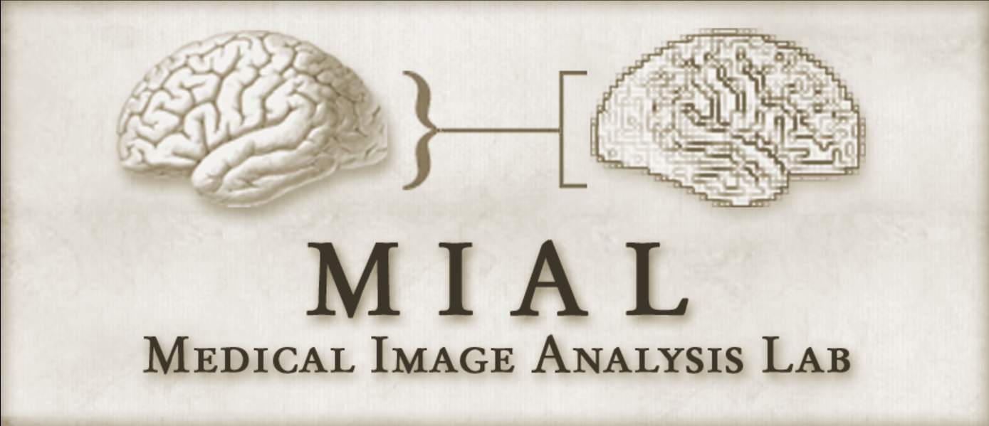
Learning to Segment Skin Lesions
from Noisy Annotations
Zahra Mirikharaji, Yiqi Yan, Ghassan Hamarneh
Presented by Saeed Izadi
Medical Image Learning with Less Labels
and Imperfect Data Workshop
MICCAI 2019 October 17, 2019

Slide 2
Motivation
Supervised learning requires several images and their associated annotations

Slide 3
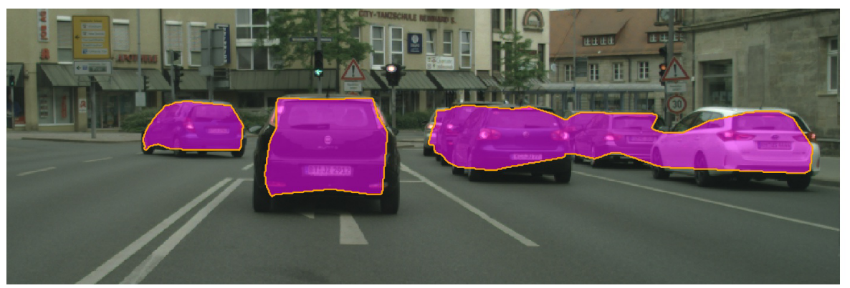
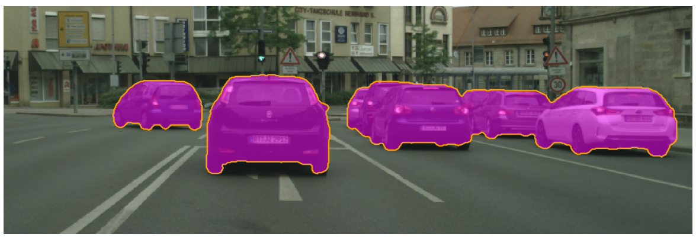
Motivation
Supervised learning requires several images and their associated annotations
Expensive expert-level annotation in contrast to cheap unreliable annotations
Adapted from “Devil is in the edges: Learning semantic boundaries from noisy annotations” by Acuna D, Kar A, Fidler S. IEEE CVPR 2019

Slide 4
Motivation
Supervised learning requires several images and their associated annotations
Expensive expert-level annotation in contrast to cheap unreliable annotations
Need for training a deep model that is robust to annotation noise
Adapted from “Devil is in the edges: Learning semantic boundaries from noisy annotations” by Acuna D, Kar A, Fidler S. IEEE CVPR 2019

Slide 5
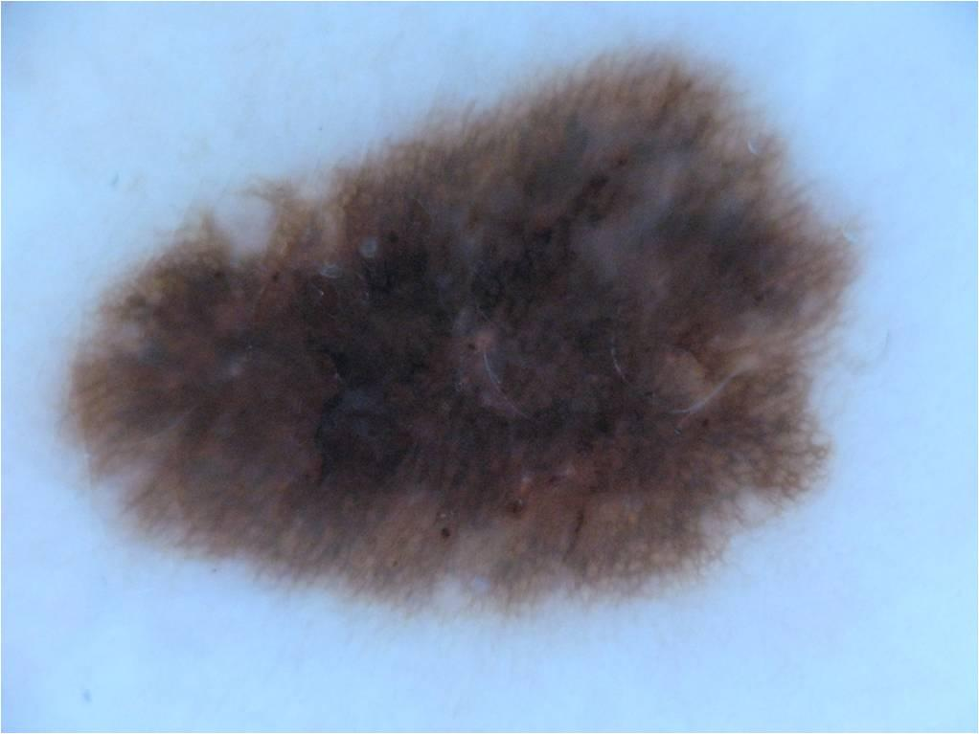
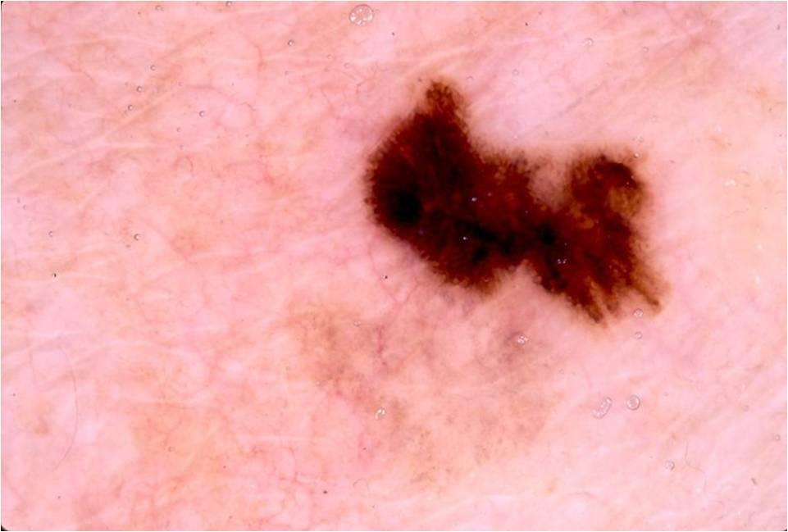
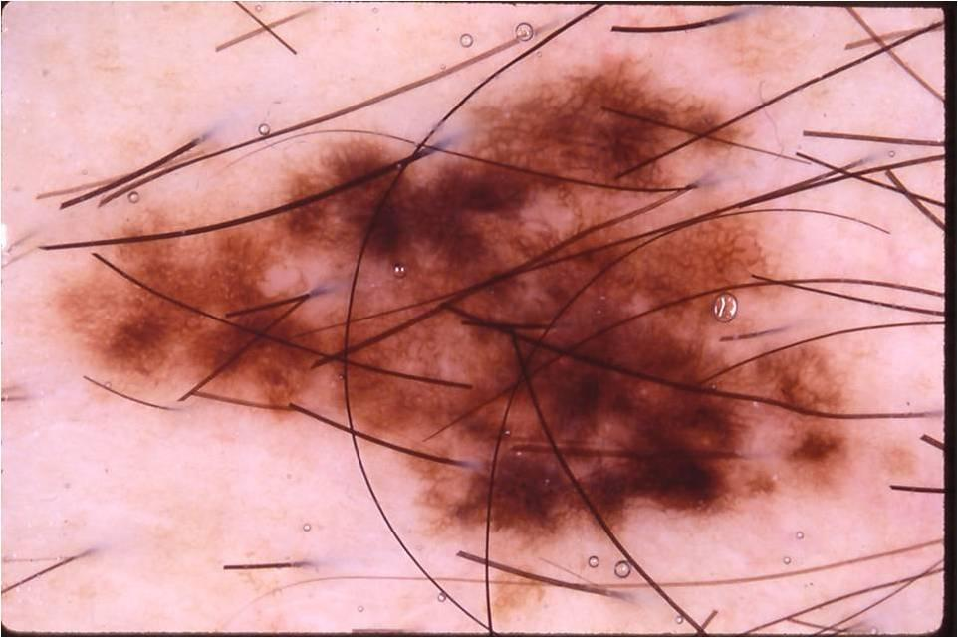
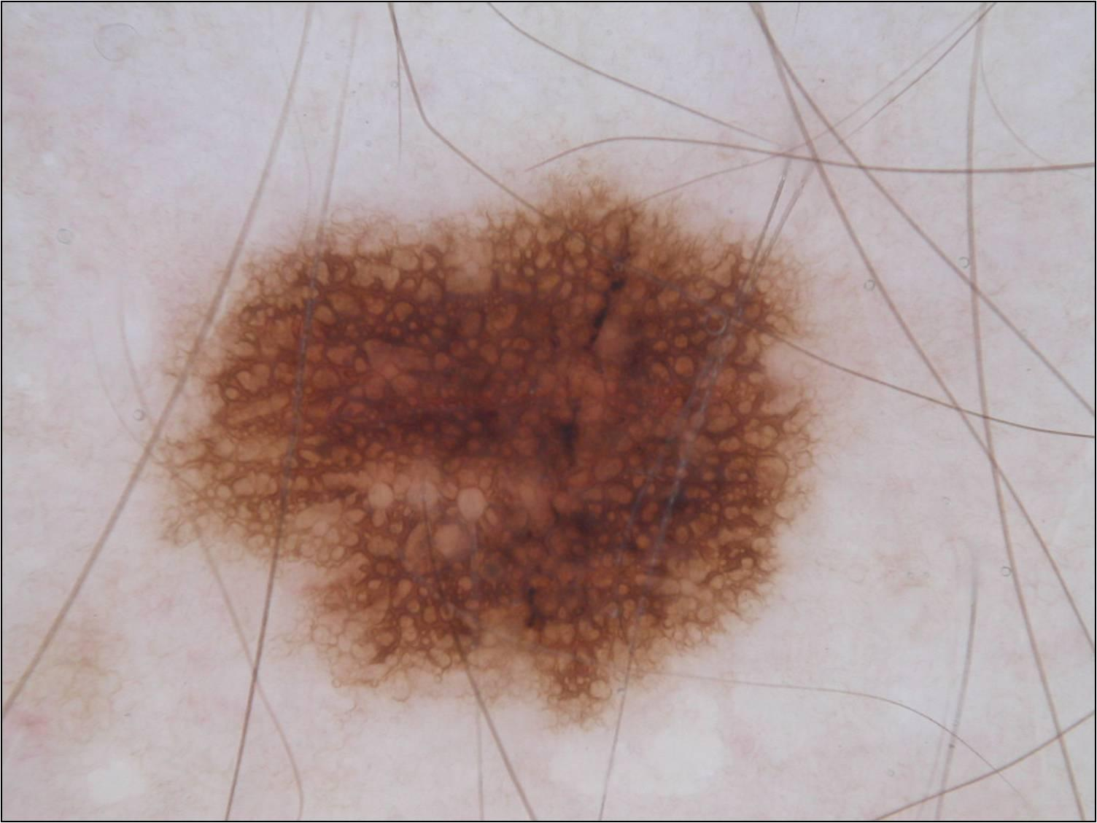
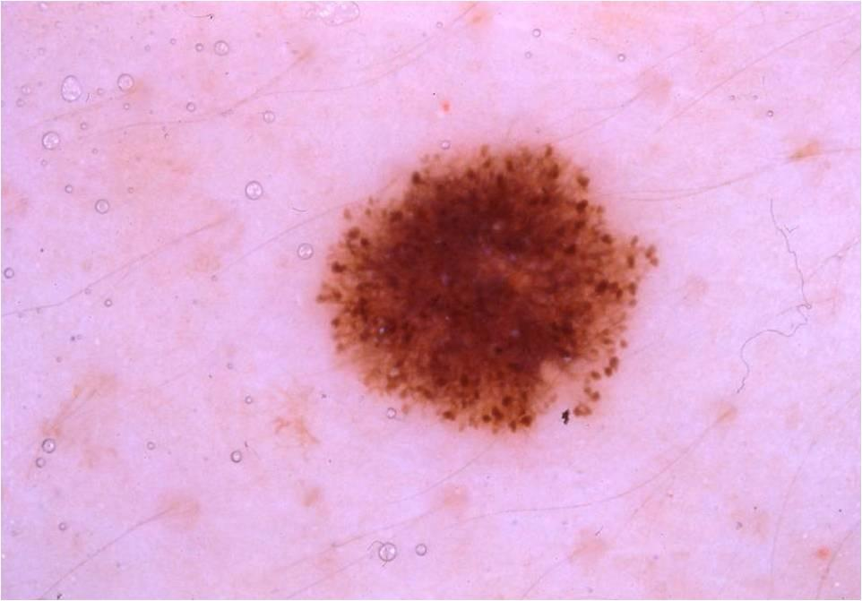
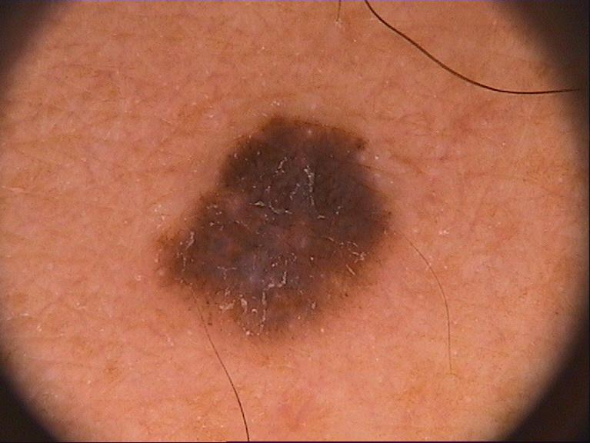
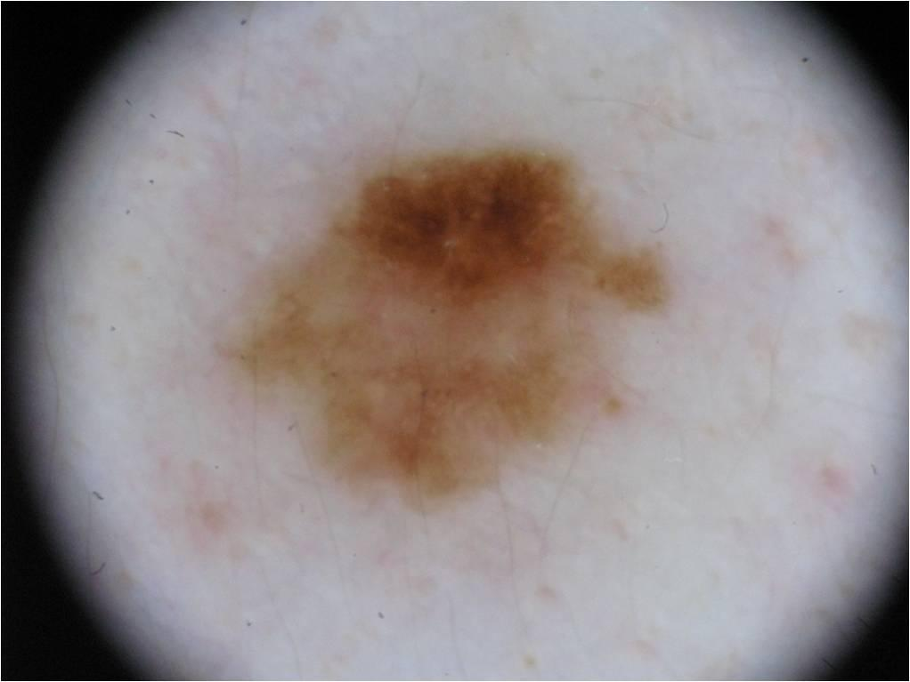
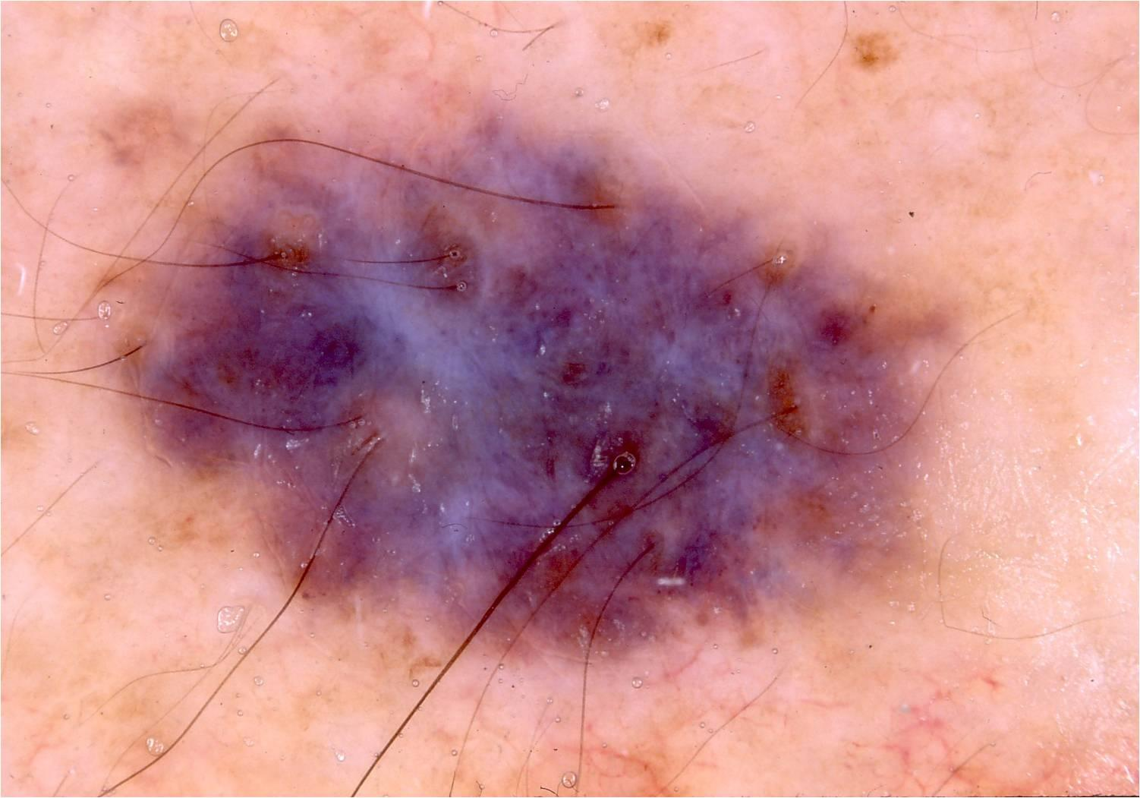
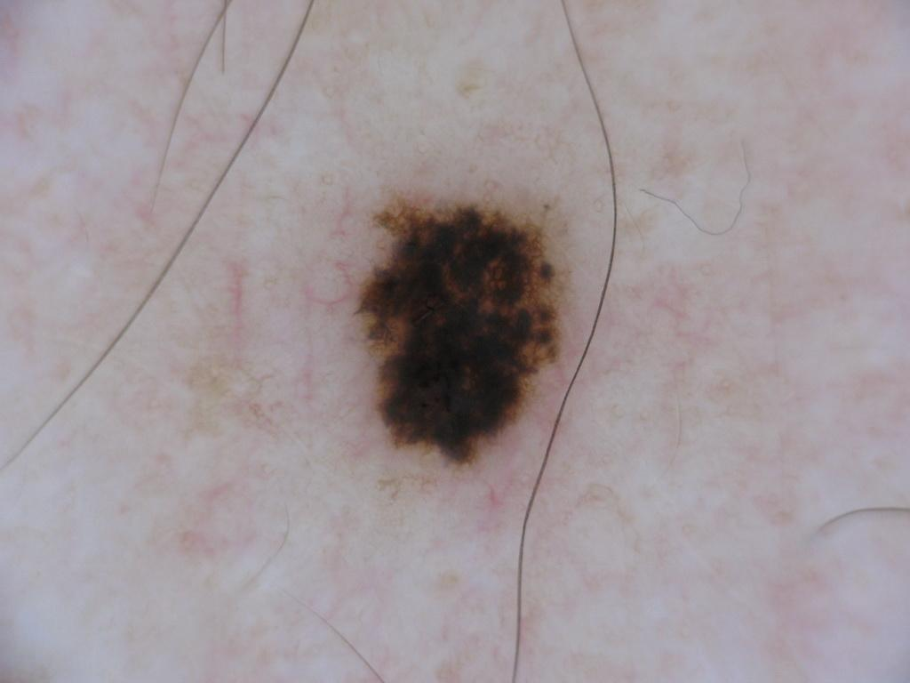
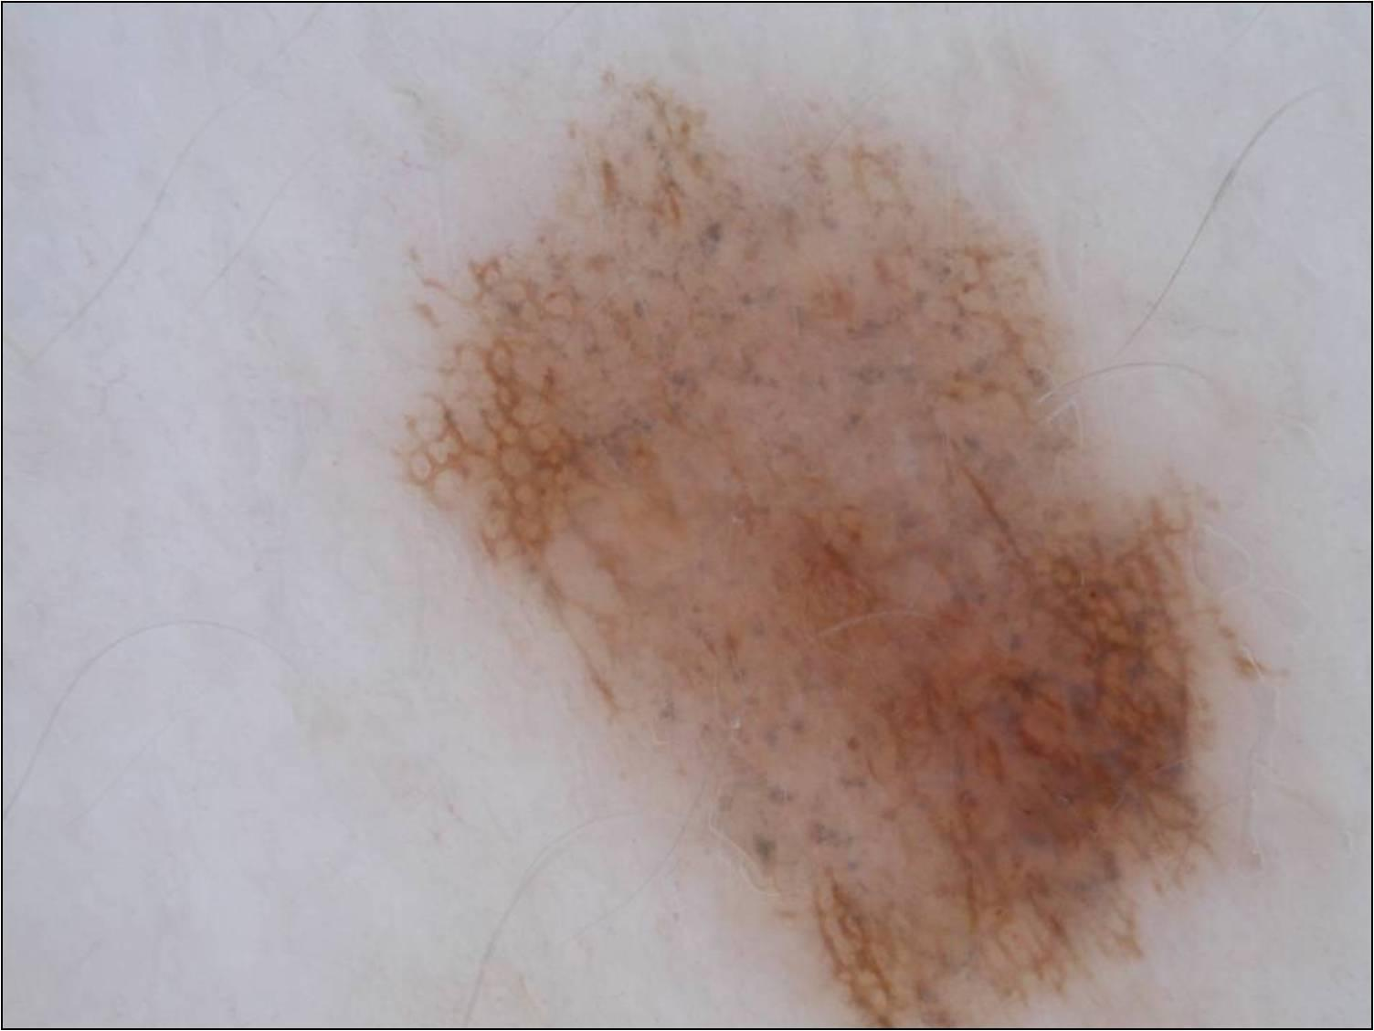
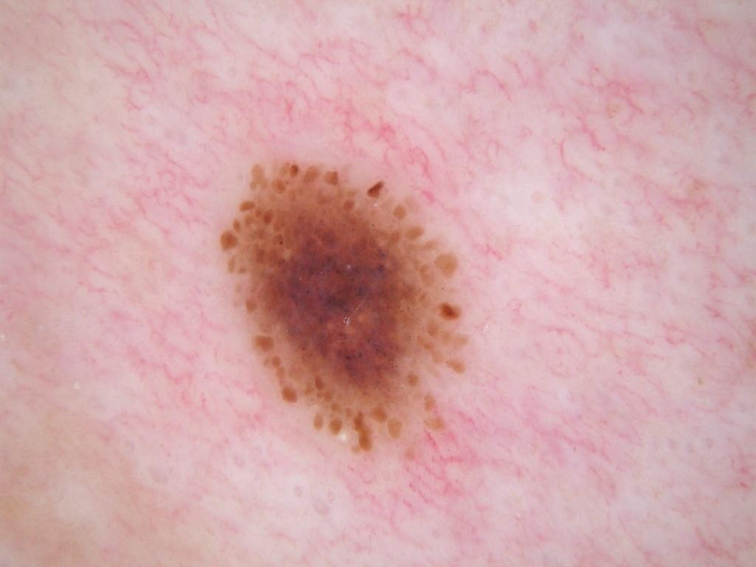
Problem
Given a dataset with two parts:
one small set of expensive expert-level annotations
and a large set of unreliable noisy annotations
Train a segmentation network that generalizes well on unseen data
=
+

Slide 6
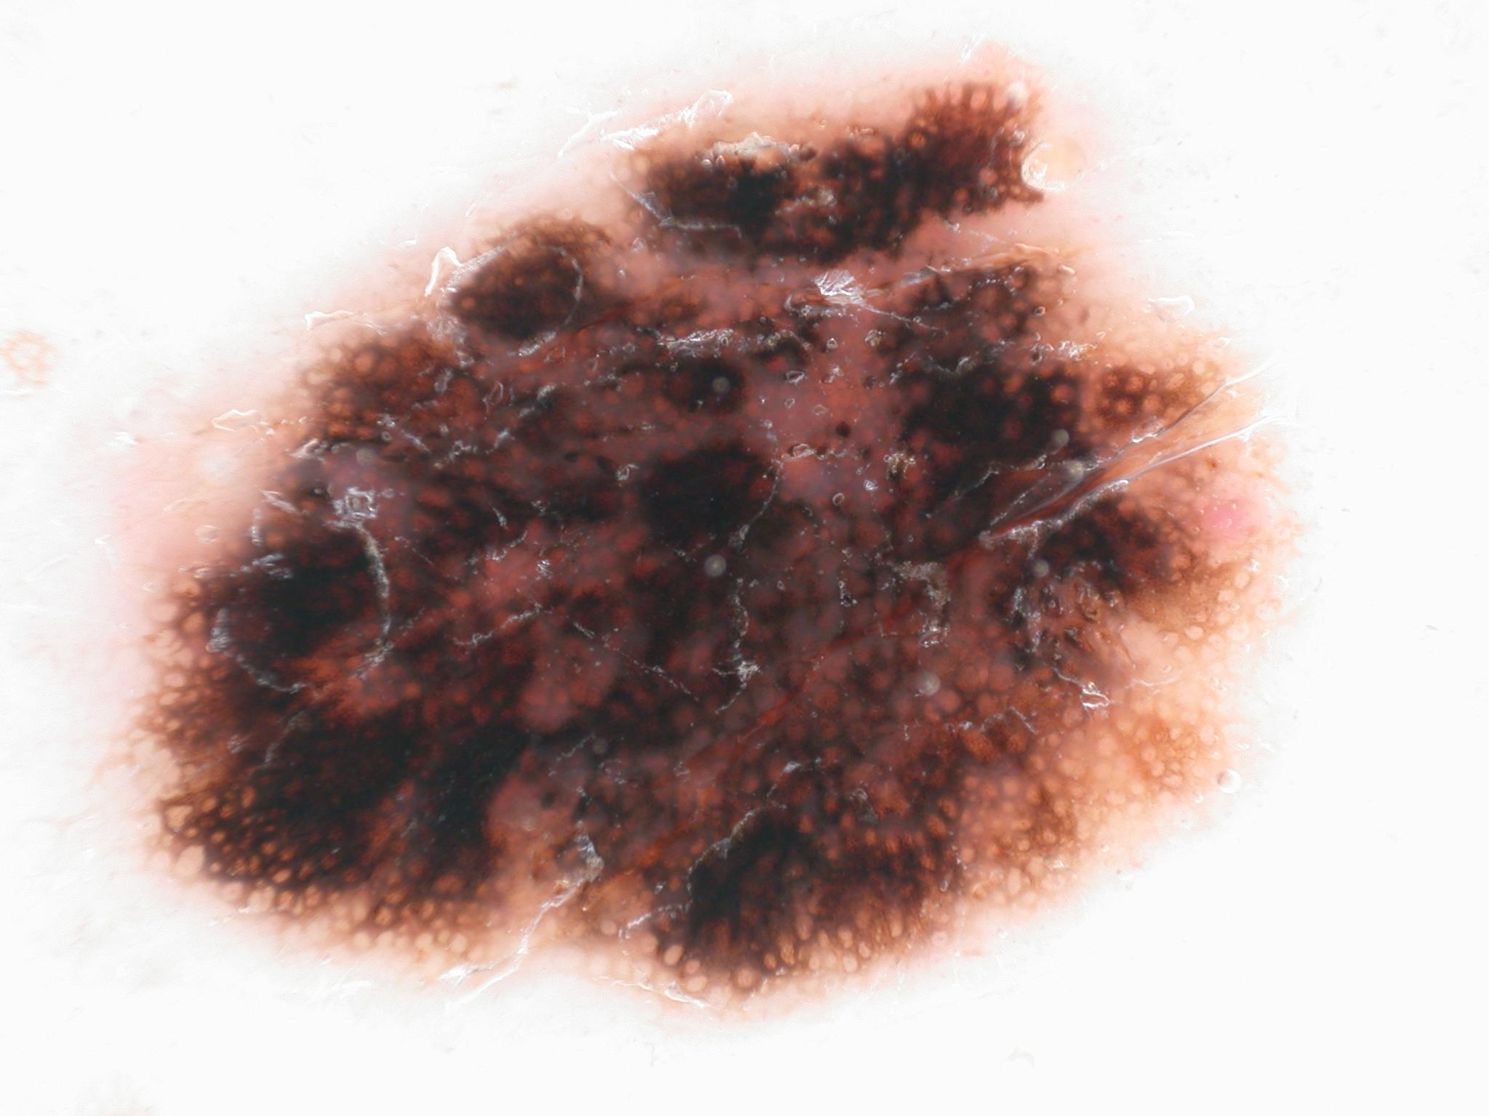
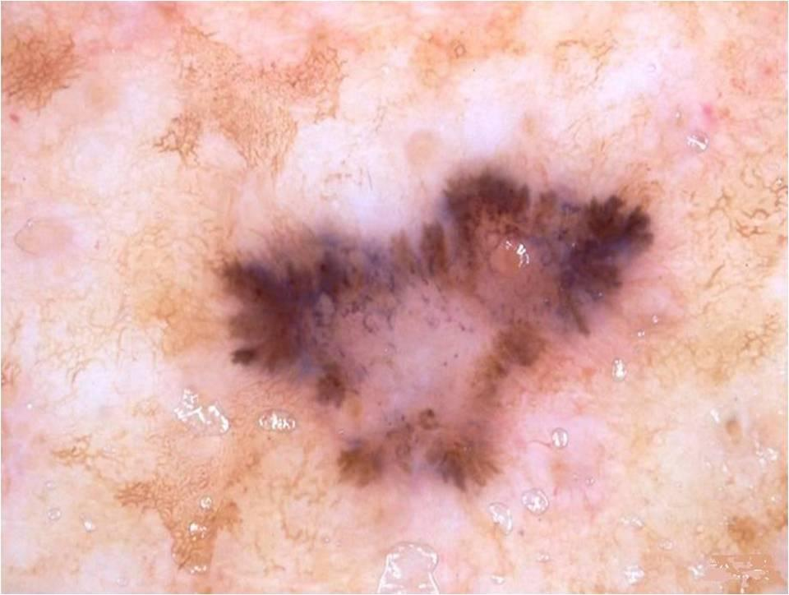
Approach
Leverage clean annotations to learn how to treat noisy annotations

Slide 7
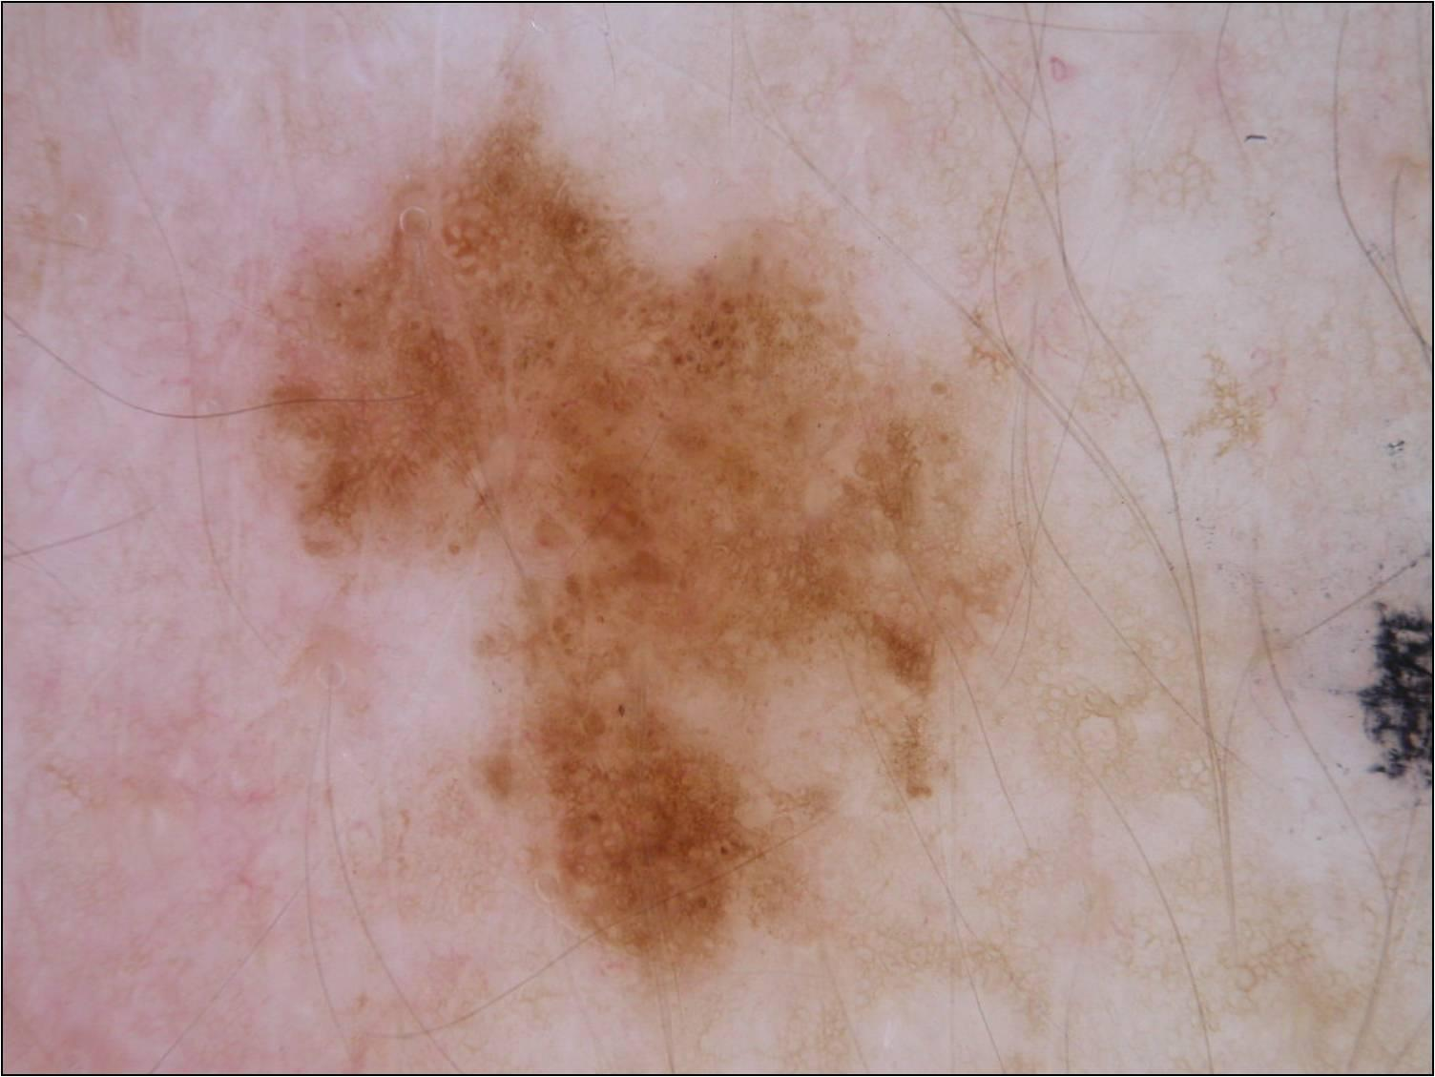
Approach
Learn a spatial weight map for each image to zero out the contribution of noisy pixel annotations in the network

Slide 8
Approach
CE loss

Slide 9
Approach
CE loss
Reweighted
loss

Slide 10
Approach
CE loss
Reweighted
loss
w_{ip} is the weight associated with pixel p of image i
W(i)={w_{i1},...,w_{ip},...,w_{iP}} and W={W(1),...,W(M)}

Slide 11
How to learn W?
Learn W dynamically by evaluating the network on clean data:

Slide 12
How to learn W?
Learn W dynamically by evaluating the network on clean data:
Learn network parameters and weight maps W, alternatively.

Slide 13
Data description
Public skin lesion images from ISIC 2017 data set
2000 training, 150 validation and 600 test images

Slide 14
Data description
Represent different levels of annotation noise: 7-vertex, 3-vertex and 4-axis-aligned-vertex polygons
Unsupervised setting: generated segmentation maps that cover the whole image (excluding a thin band around the image perimeter)

Slide 15
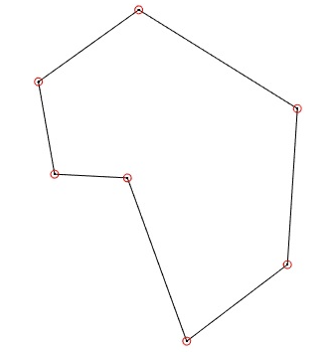
Data description
Consider a lesion boundary as a closed polygon
Mimic weak supervision: simplify a polygon by discarding less important vertices based on:
Acuteness of the angle formed by the two adjacent line segments
Adjacent line segments length
simplification

Slide 16
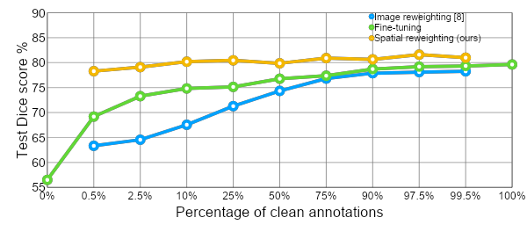
Reweighting vs. Fine-tuning
Start with 2000 images annotated by 3-vertex polygons and gradually replace some of the noisy annotation with expert-level clean annotations
Fully-supervised

Slide 17
Reweighting vs. Fine-tuning
Observe a consistent improvement in the test Dice score when the proposed reweighting algorithm is deployed.
Fully-supervised

Slide 18
Size of the clean dataset
leveraging 10 clean annotations at least 21.79% improvement in the test Dice score
Fully-supervised

Slide 19
Size of the clean dataset
Adaptive loss reweighting strategy works like a regularizer: improvement over supervised setting
with only ∼100 clean annotations, the reweighting outperforms the fully-supervised with 2000 clean annotations
Fully-supervised

Slide 20
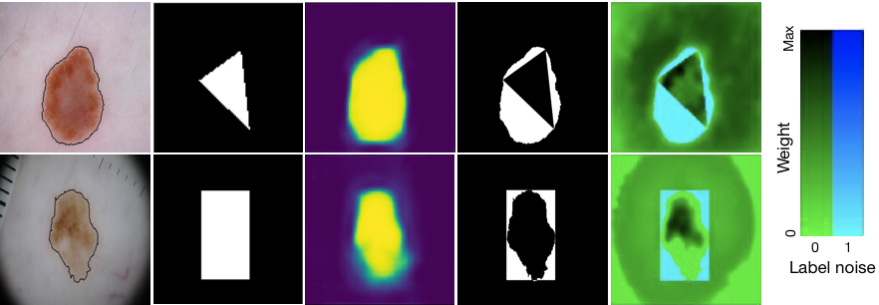
Qualitative results
Image & GT
Noisy GT
Network output
Noisy pixels
Weight maps overlaid on noisy pixels

Slide 21
Qualitative results
Image & GT
Noisy GT
Network output
Noisy pixels
Weight maps overlaid on noisy pixels

Slide 22
Qualitative results
Cyan color mean low weights are assigned to mislabelled pixels.
Image & GT
Noisy GT
Network output
Noisy pixels
Weight maps overlaid on noisy pixels

Slide 23
Conclusion
Leveraged a limited amount of cleanly-annotated data to learn a robust-to-noise deep segmentation network

Slide 24
Conclusion
Leveraged a limited amount of cleanly-annotated data to learn a robust-to-noise deep segmentation network
Learned spatially-adaptive weight maps to perform pixel-wise reweighting in the loss function

Slide 25
Conclusion
Leveraged a limited amount of cleanly-annotated data to learn a robust-to-noise deep segmentation network
Learned spatially-adaptive weight maps to perform pixel-wise reweighting in the loss function
Demonstrated on a skin lesion data set that our method reduces the requirement of careful labelling without sacrificing segmentation performance

Slide 26
Thank you!
zmirikha@sfu.ca
www.MedicalImageAnalysis.com

