Slide 1
Multi-task Learning for Neonatal Brain Segmentation Using 3D Dense-Unet with Dense Attention Guided by Geodesic Distance
Toan Duc Bui, Li Wang, Jian Chen, Weili Lin, Gang Li, and Dinggang Shen
Presenter: Fenqiang Zhao
Department of Radiology and Biomedical Research Imaging Center
University of North Carolina at Chapel Hill

Slide 2
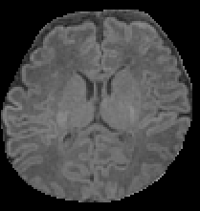
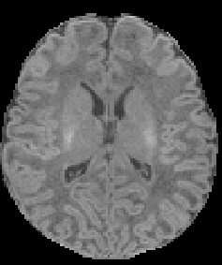
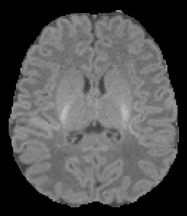
Motivation
Deep Convolutional Neural Networks (DCNN)
Good performance: training and testing images have similar distributions
Poor performance: on unseen brain image datasets
Due to different scanning protocols, tissue appearance,…
Dataset A
Dataset B
Dataset C
Notes:
- DCNN works well when we train and test on same dataset.
- But it provides a worst performance when testing dataset has different distribution with training dataset.
- The reason is that DCNN has good fitting to the training dataset, but they generally do not lead to good generalization on unseen data

Slide 3
Related Works
Single-task learning: learn a single task at once
Learn for segmentation task
Multi-task learning: learn several related tasks at once
Learn for segmentation task and regression task
Decoder
Segmentation
Decoder
Encoder
Encoder
Segmentation
Decoder
Regression
Single-task
Multi-task
Notes:
Multi-task learning is introduced to obtain a better generalization.
It learns several tasks at once. For example, segmentation task and regression task…
While, the single task only learn one task at once. For example, the single task network for segmentation is 3D-Unet

Slide 4
Proposed Method
Proposed multi-task learning for Neonatal Brain Segmentation
First branch: 3D-Unet to generate segmentation features
Second branch: estimate geodesic distance as spatial features
Third branch: combine segmentation and spatial features
CSF, WM, GM, BG
Multi-task network
Refine
Input
CSF, WM, GM, BG
Geodesic distance
map per class
Notes:
In this paper, we proposed a multi-task-based network for Neonatal Brain Segmentation.
The first task is similar 3D-Unet that learns a segmentation feature
In the second task, we learn a spatial feature that indicates the spatial relationship between voxel and tissue boundary
To further improve performance, we combined the segmentation feature and spatial feature in third branch

Slide 5
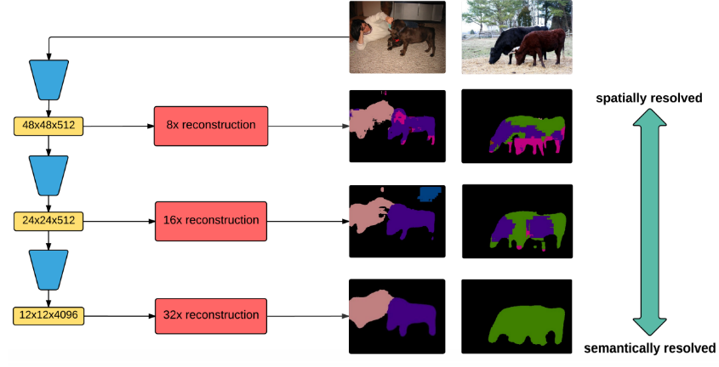
First Branch: 3D-Unet for Segmentation
Categorical ambiguity forward to decoder
Good localization
Bad discrimination
Low-level features
Bad localization
Good discrimination
High-level features
Contraction path
Expansion path
Down-sampling
Dense connection
Up-sampling
$3×3×3$Conv+ BN + ReLU
Skip connection
3D-Unet with Dense Connection
Notes:
For first branch, we modified 3D-Unet network by adding the dense attention gate.
The figure shows the weakness of 3D-Unet.
Using skip connection, the ambiguity information may directly feed to the decoder
We observe that:
Low level features: good localization, bad discrimination
High level features: bad localization (because pooling layer), good discrimination
Motivation: we use high level features to refine discrimination information in low level feature

Slide 6
First Branch: Dense Attention Gate (DAG)
$a_{DAG}^{l}=\sum_{i=l}{w_{i}a^{i}}$
DAG
Contraction path
DAG
Expansion path
DAG
Down-sampling
Dense connection
DAG
Dense Attention Gate
Up-sampling
$3×3×3$Conv+ BN + ReLU
Skip connection
3D-Unet with Dense Connection using Dense Attention
Notes:
We propose a dense attention gate to use high level features to refine discrimination information in low level feature
We assign the weight w_i for each attention vector at i^th layer. Then linear combine them. The weight w_i is learnable during training

Slide 7
First Branch: Dense Attention Gate (DAG)
$a_{DAG}^{l}=w_{l}a^{l}$ + $a_{DAG}^{l−1}$
DAG
Contraction path
DAG
Expansion path
DAG
$$≈$$
DAG
DAG
DAG
DAG
3D-Unet with Dense Connection using Dense Attention (Shorter)
Notes:
We can make the equation more shorter as the figure.
It indicates that the dense attention vector can represents by linear combination of single attention vector and dense attention vector of previous levels

Slide 8
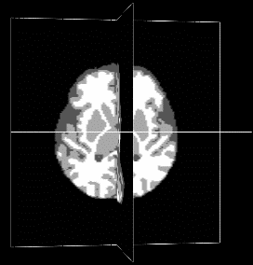
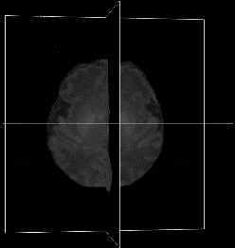
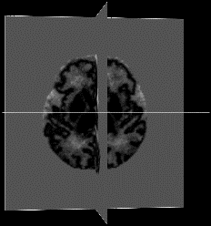
3D-Unet with DAG for Segmentation
$$L_{total}=L_{seg}+βL_{reg}+γL_{seg_reg}$$
DAG
$$L_{seg}$$
$$L_{seg_reg}$$
DAG
Label
DAG
DAG
C
C
$$×2$$
C
$$×2$$
C
$$H$$
$$W$$
$$H$$
$$H$$
C
$$H$$
$$W$$
$$W$$
$$W$$
Image
$$r=2$$
$$r=2$$
Refine net
C
C
$$×2$$
C
$$×2$$
C
$$H$$
$$W$$
DAG
DAG
$$L_{reg}$$
DAG
DAG
3D-Unet with DAG for Reconstruction
Geodesic
distance
C
Encoding feature
Decoding feature
DAG
Dense Attention Gate
Concatenation
$$×2$$
Up-sampling by 2
r is dilation rate. I use r=2 to increase receptive field without pooling
Notes:
We propose a multi-task learning architecture network
Firstly, we add our dense attention gate to the 3D-Unet to learn segmentation feature
Secondly, we add another branch to learn spatial feature via regression network to recover the geodesic distance. The distance indicates the distance between voxels and tissue boundary
Thirdly, we combine the segmentation and spatial feature to refine the segmentation result
(Some notation: C is concatenation, x2 is upsampling by 2, r is dilation rate)

Slide 9
Experimental Setting
Three datasets with different scanning protocols
Datasets | Scanners | Resolutions | Parameters (TR/TE)
A (# sub.=25) | GE | 0.9375x0.9375x1 | 10.47/4.76
B (# sub.=10) | Siemens | 0.8x0.8x0.8 | 2400/2.24
C (# sub.=10) | Siemens | 1x1x1 | 1900/4.38
r is dilation rate. I use r=2 to increase receptive field without pooling
Notes:
We evaluate on three dataset A, B and C with different scanning protocol as show in the table 1
We train on dataset A and evaluate on B and C
The table 2 shows that all method provide a good result when training and testing come from same distribution. It also shows advantage of propose dense attention gate
The table 3 shows that our method provide better performance on unseen dataset B and C comparison with the 3D-Unet

Slide 10
Experimental Results
Train and test on Dataset A
Method | CSF | GM | GM | Avg. DSC
3D-Unet | 97.65 | 96.85 | 98.51 | 97.67
3D-Unet+DAG | 97.75 | 97.06 | 98.59 | 97.80
3D-Unet+DAG+DR | 97.88 | 97.18 | 98.65 | 97.90
Train on Dataset A and test on Datasets B and C
Method | DSC (%) | HD (mm)
3D-Unet | 84.55 | 2.28
3D-Unet+DAG+DR | 85.85 | 1.16
3D-Unet | 89.02 | 1.32
3D-Unet+DAG+DR | 90.29 | 1.11
Dataset B
Dataset C
r is dilation rate. I use r=2 to increase receptive field without pooling
Notes:
Models train on dataset A and test on dataset B and C
A good performance if training and testing have same distribution
Poor performance on unseen dataset
We evaluate on three dataset A, B and C with different scanning protocol as show in the table 1
We train on dataset A and evaluate on B and C
The table 2 shows that all method provide a good result when training and testing come from same distribution. It also shows advantage of propose dense attention gate
The table 3 shows that our method provide better performance on unseen dataset B and C comparison with the 3D-Unet

Slide 11
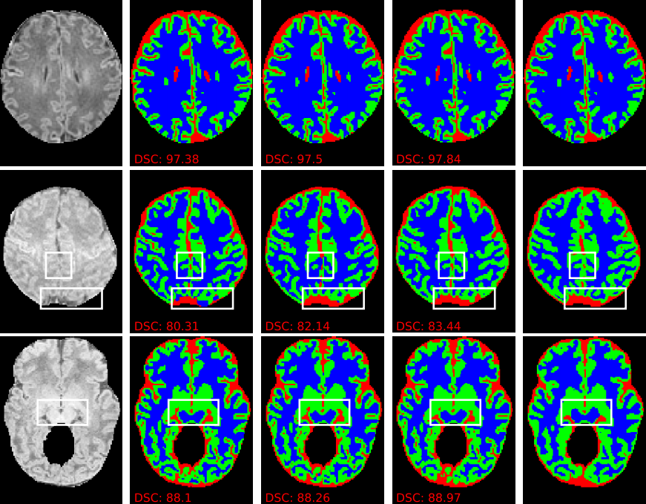
Experimental Results
Dataset A
Dataset B
Dataset C
3D-Unet
3D-Unet + Attention
Proposed method
Ground-truth
r is dilation rate. I use r=2 to increase receptive field without pooling
Notes:
- This figure show some example results on dataset A, B and C

Slide 12
Conclusion
Propose a dense attention gate
Learn the contextual information from high level features
Propose multi-task learning for neonatal brain segmentation
Allowing network to learn both spatial and segmentation features
Good generalization on unseen datasets
Notes:
In conclusion, we proposed
A dense attention gate to refine the encoder feature maps before feed them to the decoder path
We utilize the multi-task learning to guide the network learn the spatial feature and segmentation feature

Slide 13
Thank you for listening!
Contact: toanbui@email.unc.edu

