Slide 1
CT Data Curation for Liver Patients: Phase Recognition in Dynamic Contrast-Enhanced CT
Bo Zhou^{1,2} , Adam P. Harrison² , Jiawen Yao² , Chi-Tung Cheng⁴ ,
Jing Xiao³ , Chien-Hung Liao⁴ , and Le Lu²
¹ Biomedical Engineering, Yale University, New Haven, CT, USA
² PAII Inc., Bethesda, MD, USA
³ PingAn Technology, Shenzhen, China
⁴ Chang Gung Memorial Hospital, Linkou, Taiwan, ROC

Slide 2
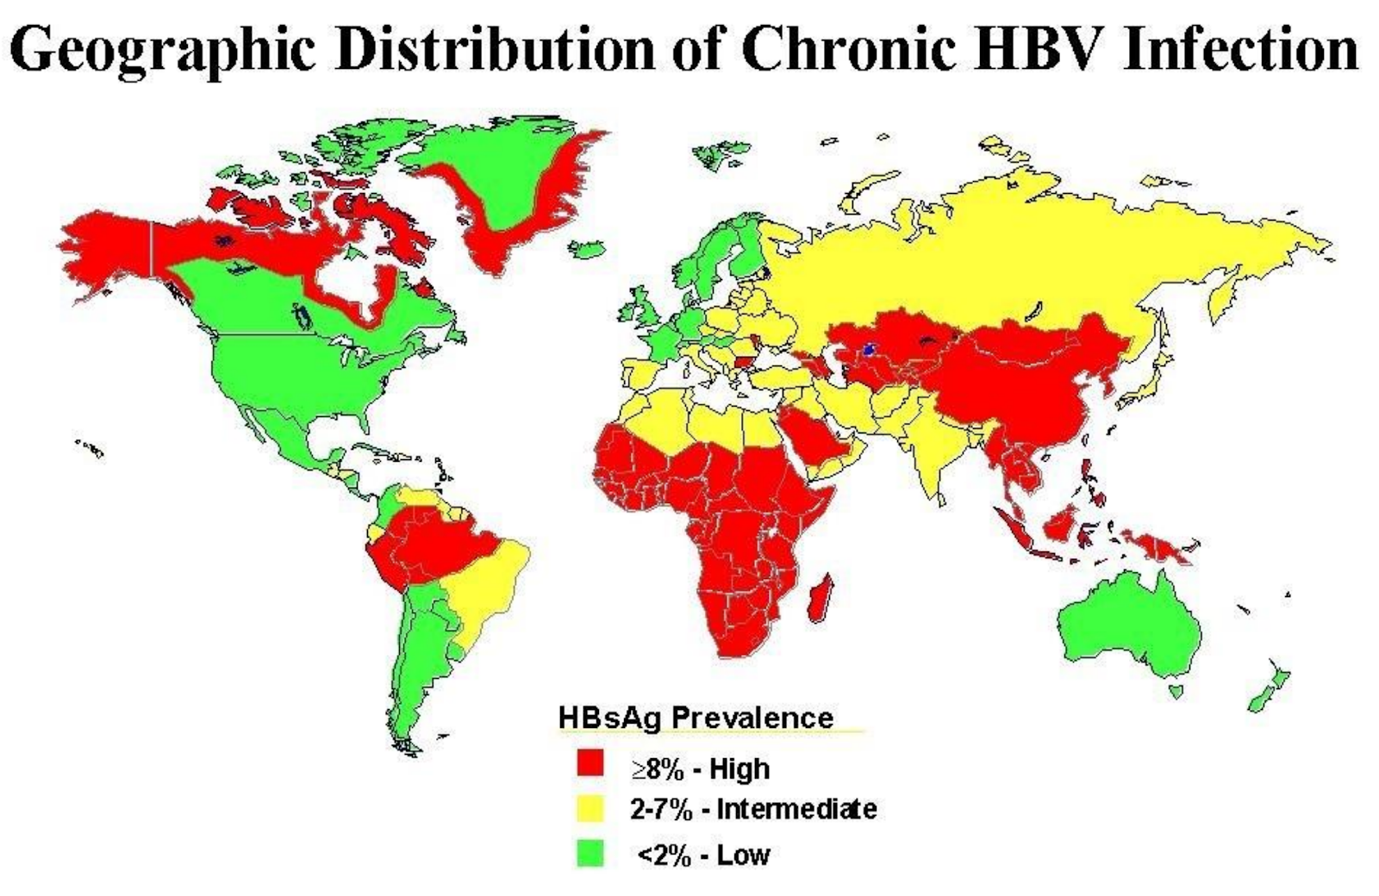
Motivation: Liver Disease in East Asia
Liver cirrhosis: 9th leading cause of death
Liver cancer: 2nd leading cause of cancer death (High prevalence of Hep B and Hep C in East Asian populations)
Early detection/characterization can make a huge difference in prognosis/management

Slide 3
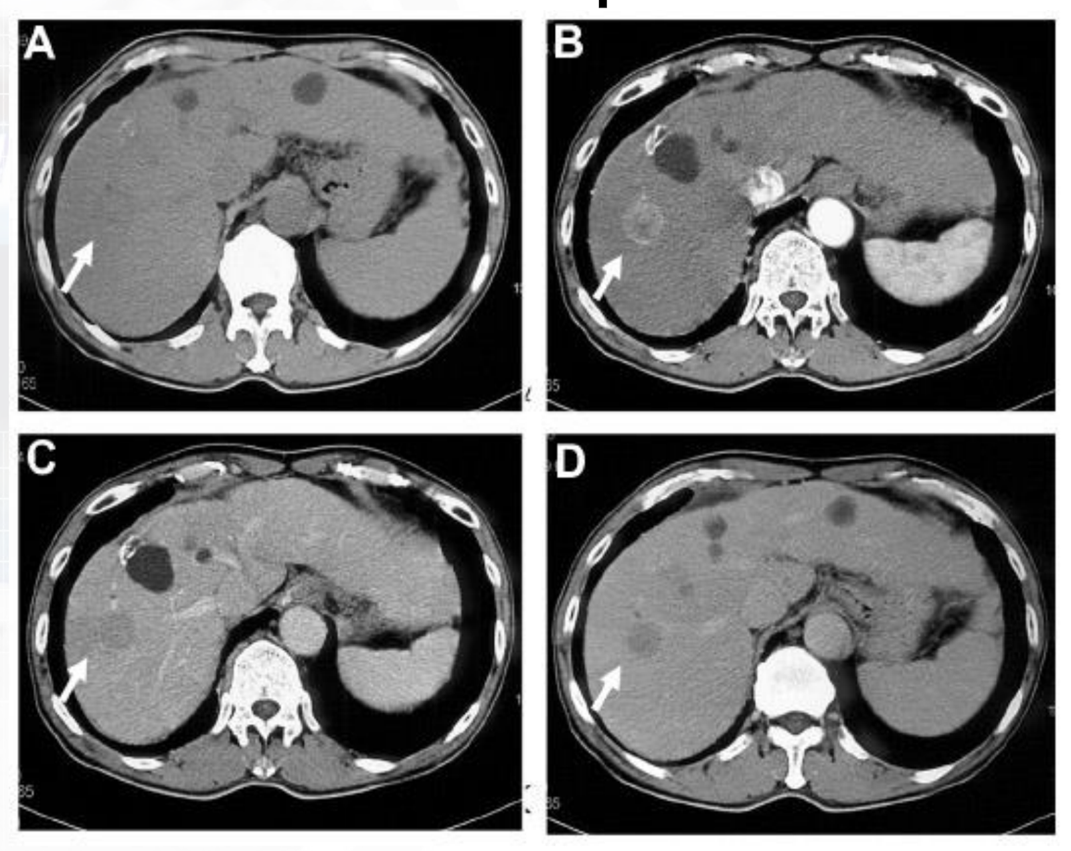
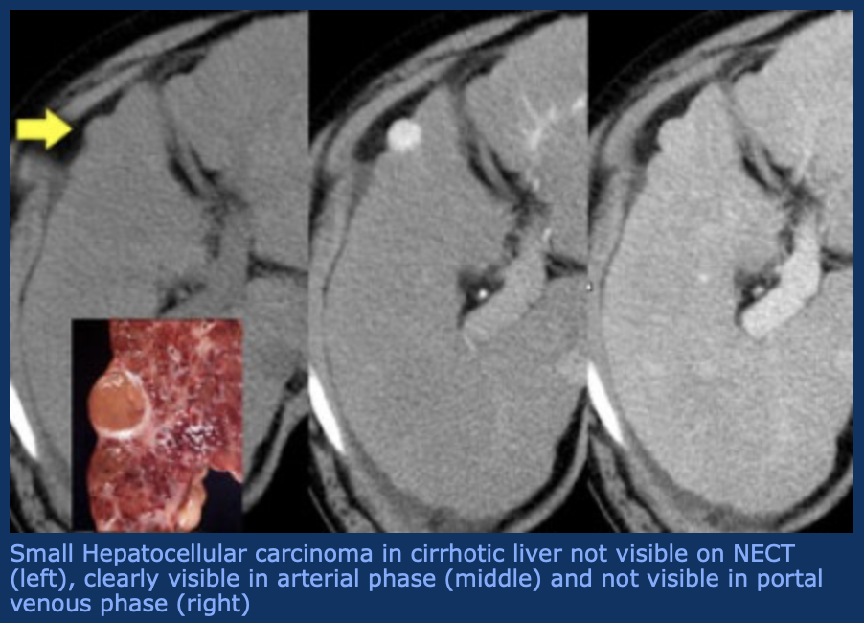
Motivation: Liver Dynamic CT & Deep Learning
Dynamic CT:
Inject contrast agent into patient and image at different phases (arterial, venous, delay)
Lesions can be differentiated by their reaction to contrast
Deep learning using Liver Dynamic CT:
Robust performance often requires training from large-scale data.
Mining physician expertise by collecting retrospective data from PACSs.

Slide 4
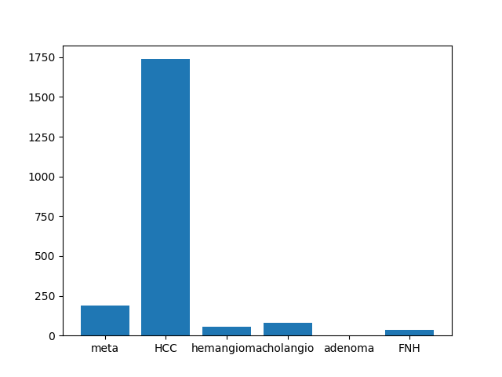
Motivation: Liver Data Curation Needed
Chang Gung Memorial Hospital Dynamic CT Data:
7,941 studies, comprising 4,774 patients and ~43K scans
Gold standard pathology diagnosis for each study
Challenges:
PACS data is not curated for machine learning.
DICOM tags are typically hand inputted, non-standardized, and often incomplete.
Produce high mislabeling rates, e.g., the 15% rate reported by Gueld et al*.
*Gueld et al, Quality of dicom header information for image categorization. In: Proceedings of SPIE Medical Imaging. (2002)

Slide 5
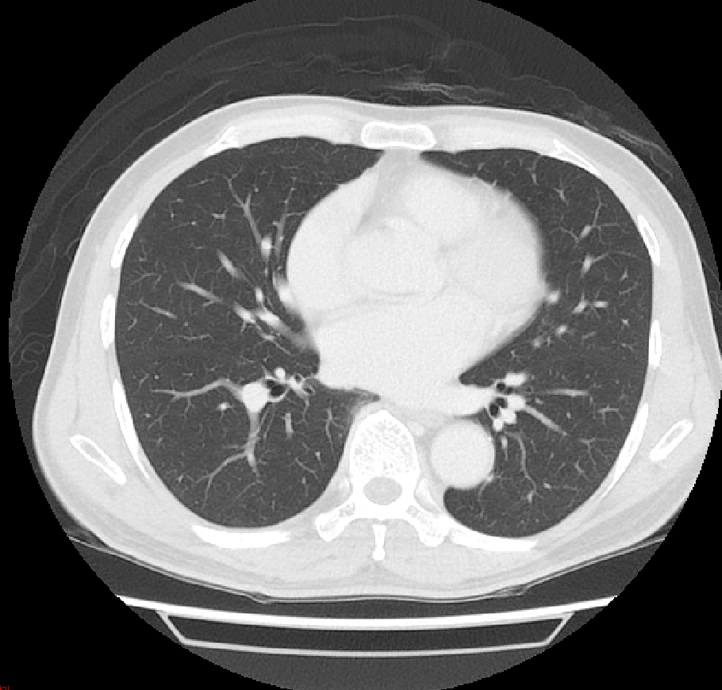
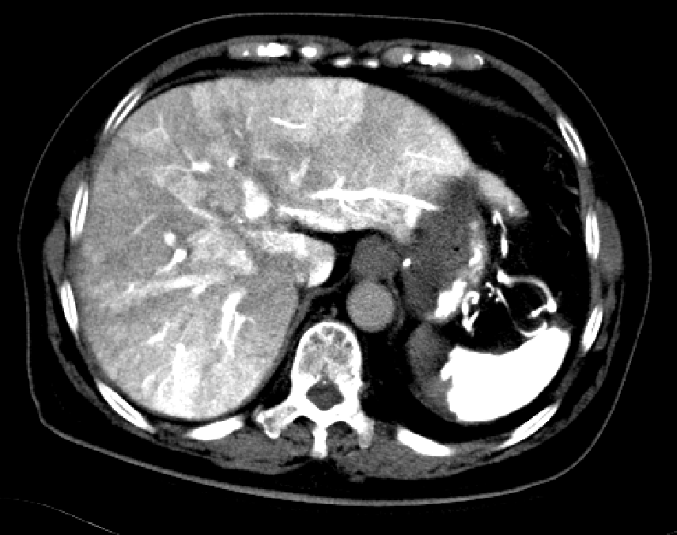
Motivation: Liver Data Curation Needed
Before proceeding to downstream liver tasks, we need to know each scan type:
Is it focused on liver ?
Is it axially reconstructed ?
What dynamic phase is it ?
Ideally, we can just use DICOM tags. But they are unreliable, noisy, or missing
Non-liver scan
(Lung scan)
CTAP
(CT Arterial Portography)
Non-liver scans | Not always reliably indicated
CTAP | Not always reliably indicated
“Contrast” | Some scans only labelled as “contrast”, can be one of the phase

Slide 6
M
Methods: Pipeline
Goal:
With minimal labour, automatically identify and extract scans of interest:
non-contrast, arterial, venous, and delay scans, with liver in field of view
everything else as “other”: CTAP studies, non-liver scans, non-axial reconstructions
Strategy:
Use simple text matching rules to create noisy labels from DICOM tags
Train 3D CNN on noisy labels, and use it to more reliably identify scans
Messy
Hospital
Dataset
Embarrassingly
Simple Text
Matching
Noisy Labels
Train CNN
Apply CNN
on Messy Data
Curated
Hospital
Dataset
Cleaned Labels

Slide 7
M
Methods: Phase Curation Model
Adapted C3D 3D classification model*
Simplified model to only two convolutional layers because visual tasks is not complex
Model with shallow layers, global information is not well-used
Added squeeze and excitation layers** to create more global context
Result is simple but global model: 3DSE
*Tran, D., et al, Learning spatiotemporal features with 3d convolutional networks. In: IEEE international conference on computer vision. (2015) 4489–4497
**Hu, J., et al.: Squeeze-and-excitation networks. In: IEEE conference on computer vision and pattern recognition. (2018) 7132–7141

Slide 8
M
Methods: ACE Loss for Using All Data
Some scans only labelled as “contrast”
But, we want fine-grained labels: “arterial”, “venous”, or “delay”
Still contains useful info => We should use for training !
Derived numerically stable Aggregated Cross Entropy (ACE) loss to train fine-grained outputs

Slide 9
M
Quantitative Results
3DSE can outperform text-mining
Squeeze and excitation layers and ACE both add to performance
Larger models tend to overfit => 3DSE + ACE can outperform them

Slide 10
M
Qualitative Results
3D Respond-CAM* visualizations demonstrate the model attends to logical areas in the CT scan, where the contrast resides.
*Zhao, G. Zhou, B, et al,.: Respond-cam: Analyzing deep models for 3d imaging data by visualizations. In: Medical Image Computing and Computer-Assisted Intervention (2018) 485–492

Slide 11
M
Conclusion
Developed phase curation system that can identify scans with minimal labour
Trained on noisy DICOM tags
Innovations:
Effective and straightforward 3DSE model
Aggregated cross entropy loss to use weakly labelled “contrast” scans
Boosts mean F1 score from 93.8 to 97.7
Can correctly identify all scans in 92.7% of studies
Compared to 80.9% of studies using text mining
Important milestone in larger Liver CT project

Slide 12
M
CT Data Curation for Liver Patients
Thank you for your attention

